Slide 2
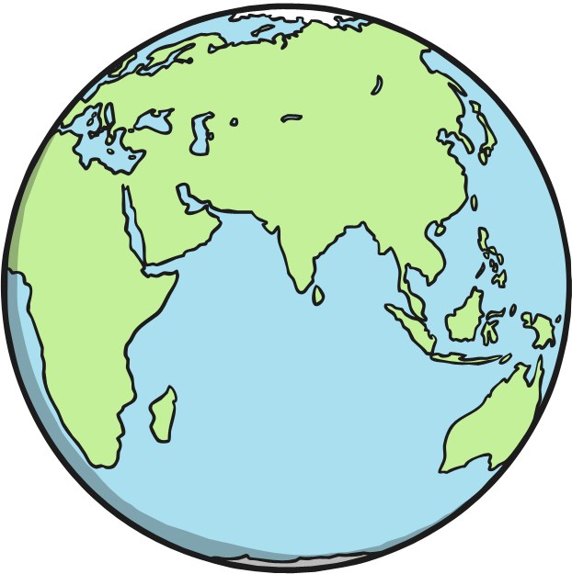
The South Pole
Planet Earth is a sphere, which means it is shaped like a round ball.
It has two ends – the North Pole and the South Pole.

Slide 3
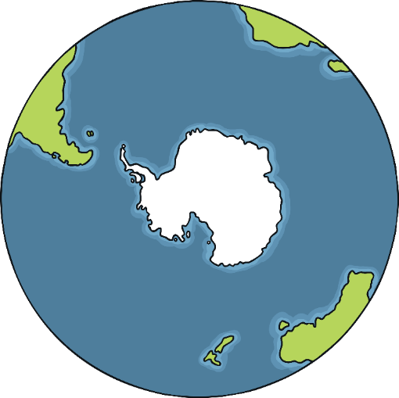
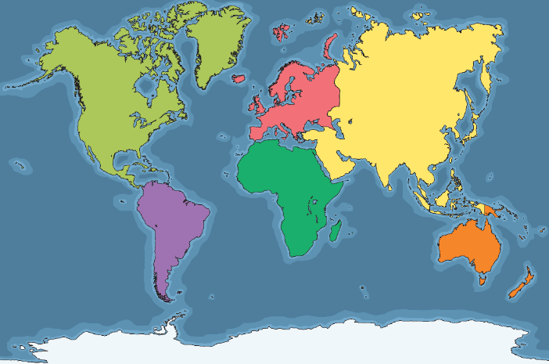
The South Pole
Do you know which continent the South Pole is in?
North America
Europe
Asia
South America
The South Pole is in Antarctica.
Africa
Antarctica
Australasia

Slide 4
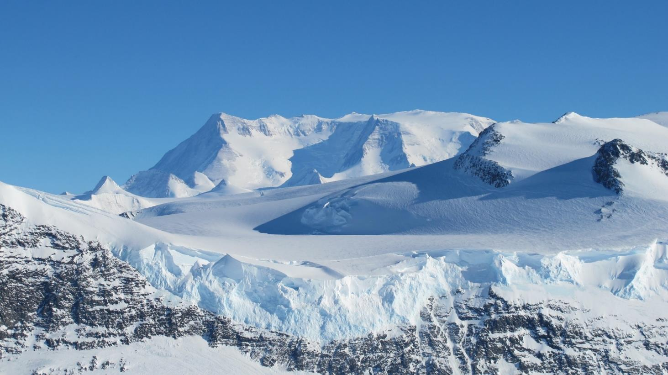
Antarctica
Antarctica is the coldest, driest and windiest continent on Earth.
Although it is covered in ice and snow, it is dry because it hardly ever rains.
It is very difficult for plants and animals to survive here.

Slide 5
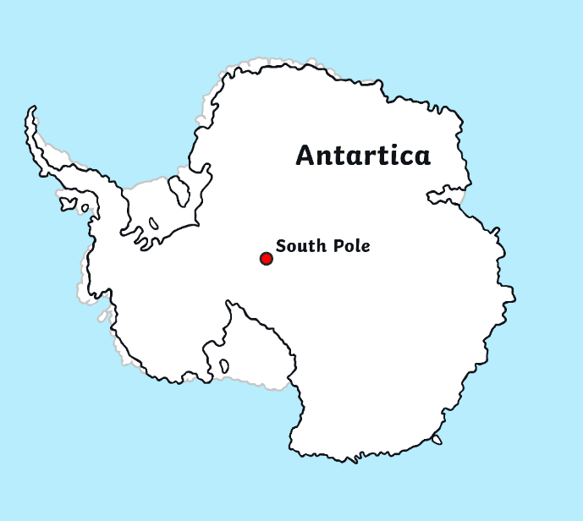
Antarctica
For thousands and thousands of years, no humans had ever been to Antarctica.
They weren’t even sure it existed!
In the 18th and 19th centuries, many brave explorers tried to find it.
Eventually, humans found Antarctica!
Once it was discovered, the next challenge was to reach the South Pole.

Slide 6
Task:
Find out about the explorers who tried to reach the South Pole. Write a newspaper article about a successful team of explorers. Use the slides to help you.
Make sure your report looks like a newspaper article
Does it have all the important features.
You might want to make yourself some notes as you go through the slides.
Perhaps you could find extra information and pictures of your own using the internet?
Useful link:
https://www.bbc.co.uk/teach/class-clips-video/ks2-robert-falcon-scott/zdhdgwx

Slide 7
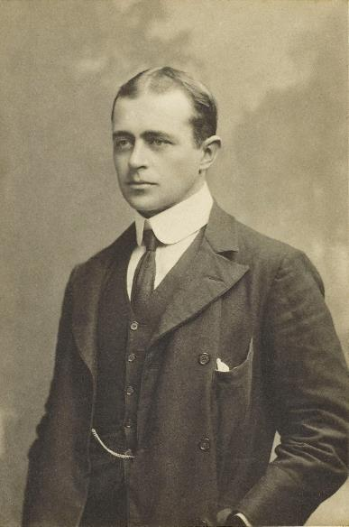
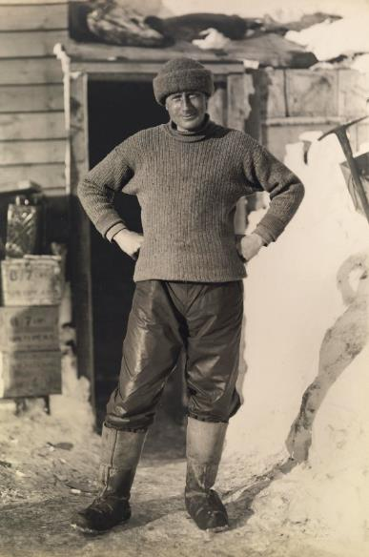
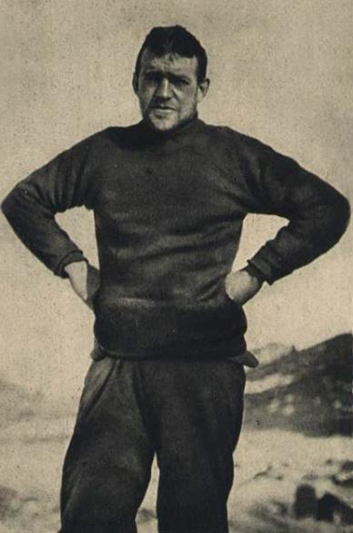
Reaching the South Pole
In 1902, Robert Scott, Edward Wilson and Ernest Shackleton set off to try to find the South Pole on the Discovery Expedition.
Scott
Wilson
Shackleton

Slide 8
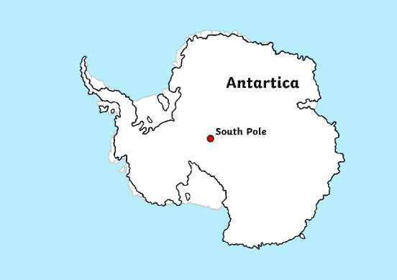
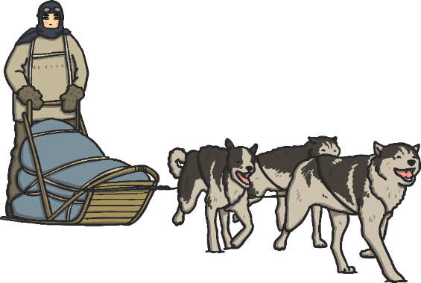
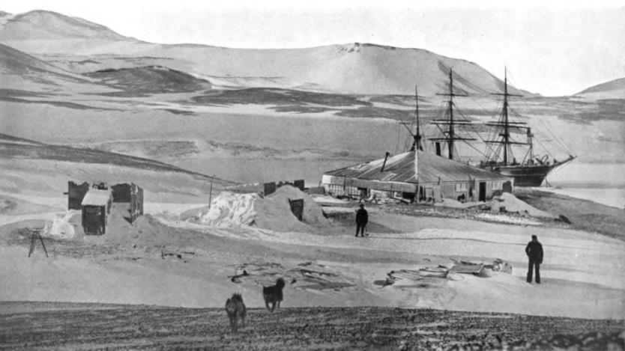
Discovery Expedition
The team travelled on a sledge pulled by dogs.
They reached further south than anyone had before!
Eventually, they were forced to turn back before reaching the South Pole.
By the time they returned to their ship, the explorers were all suffering from scurvy and frostbite.

Slide 9
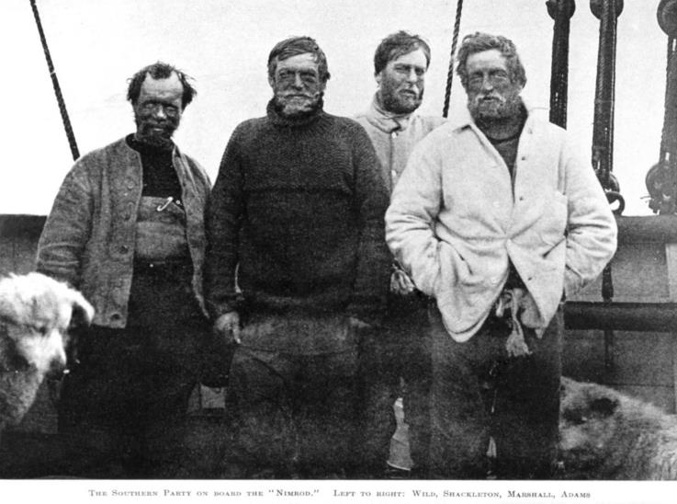
Nimrod Expedition
In 1908, Ernest Shackleton made another attempt to reach the South Pole on the Nimrod Expedition.
Alongside him were Frank Wild, Eric Marshall and Jameson Adams.
Shackleton
Can you spot their sledge dogs?

Slide 10
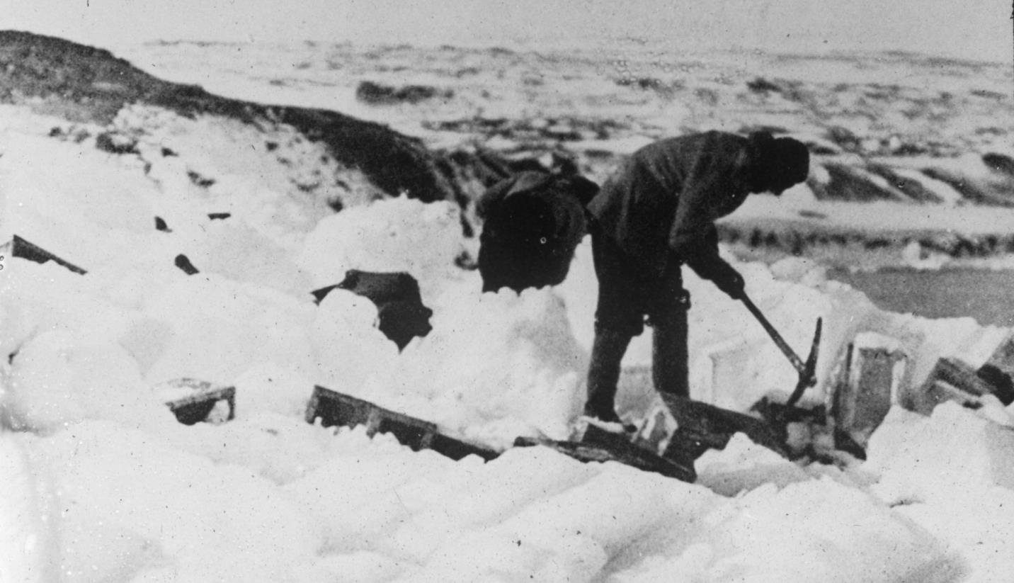
Nimrod Expedition
Travelling across Antarctica was extremely hard work.
They had to make their way across ice and through thick snow, using pickaxes to clear their path.

Slide 11
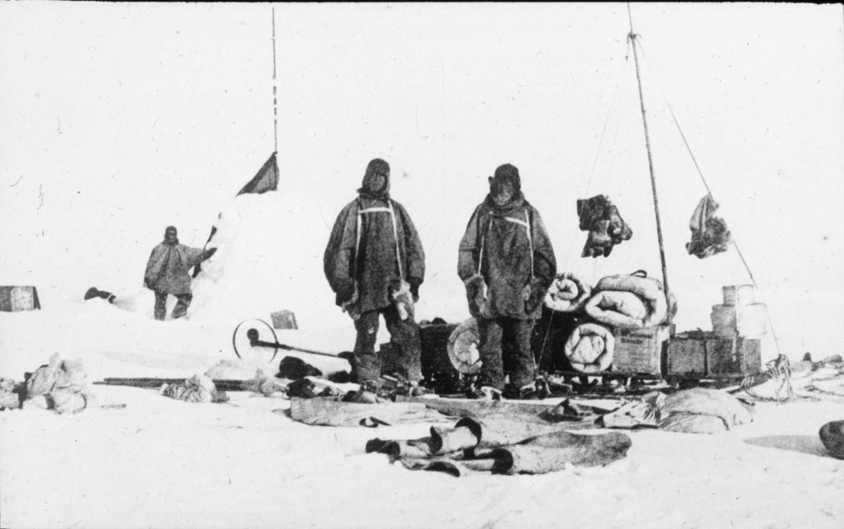
Nimrod Expedition
The team had to battle against temperatures as low as −90°C.
They had to carry all of their food, clothes, maps and other essentials.

Slide 12
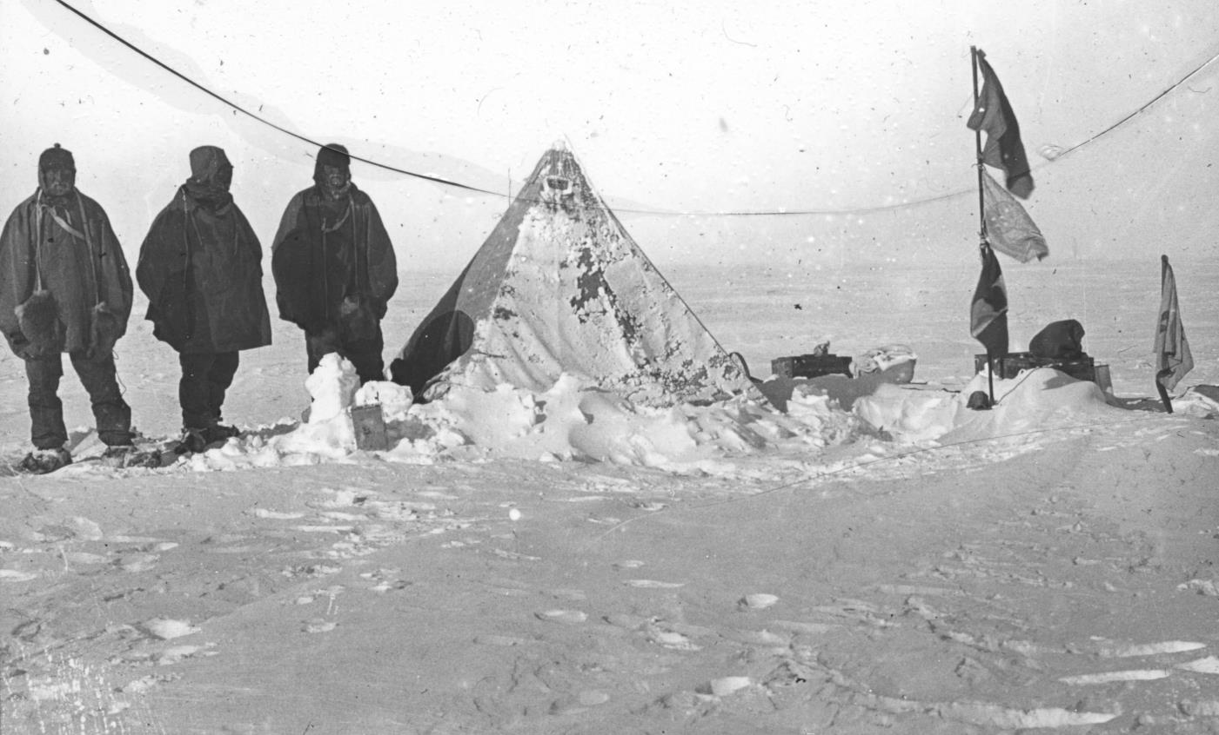
Nimrod Expedition
They had to set up camp on the ice when they needed to rest.
Can you imagine building your home every bedtime?

Slide 13
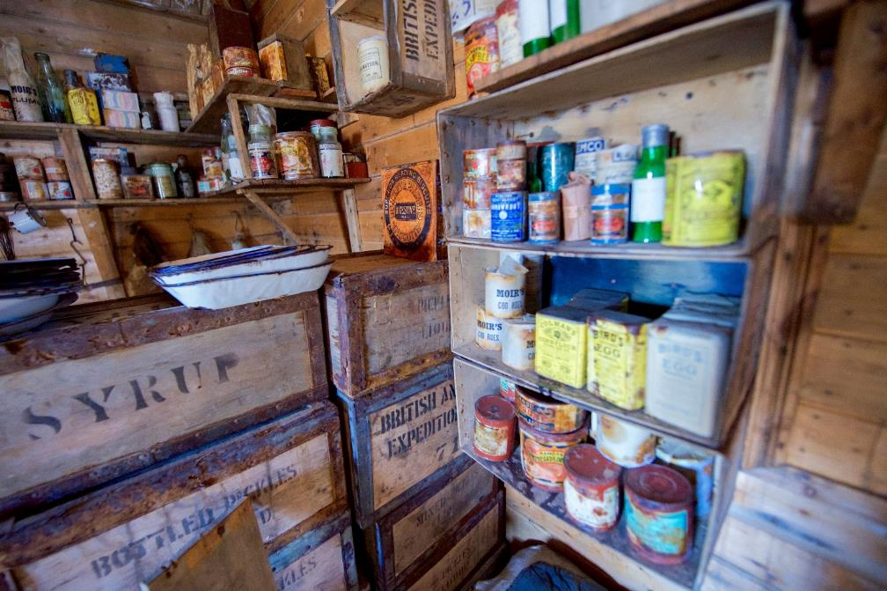
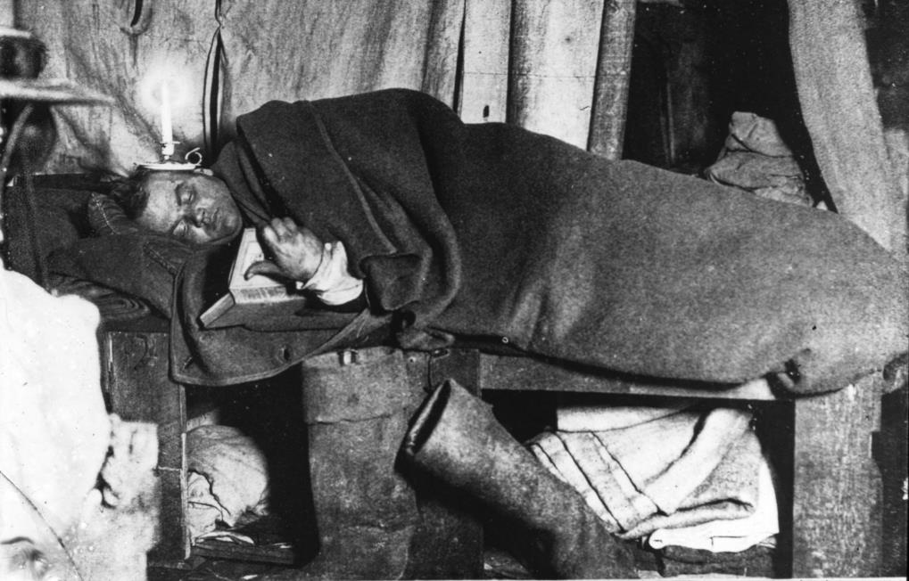
Nimrod Expedition
They had limited food.
There was no heating or electricity.
Can you see what Eric Marshall is using for light inside the tent?

Slide 14
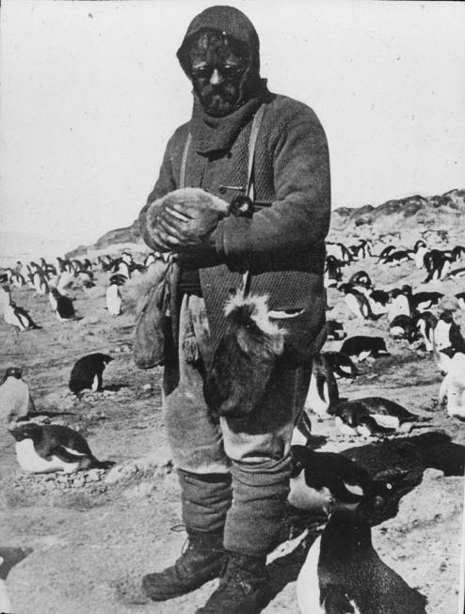
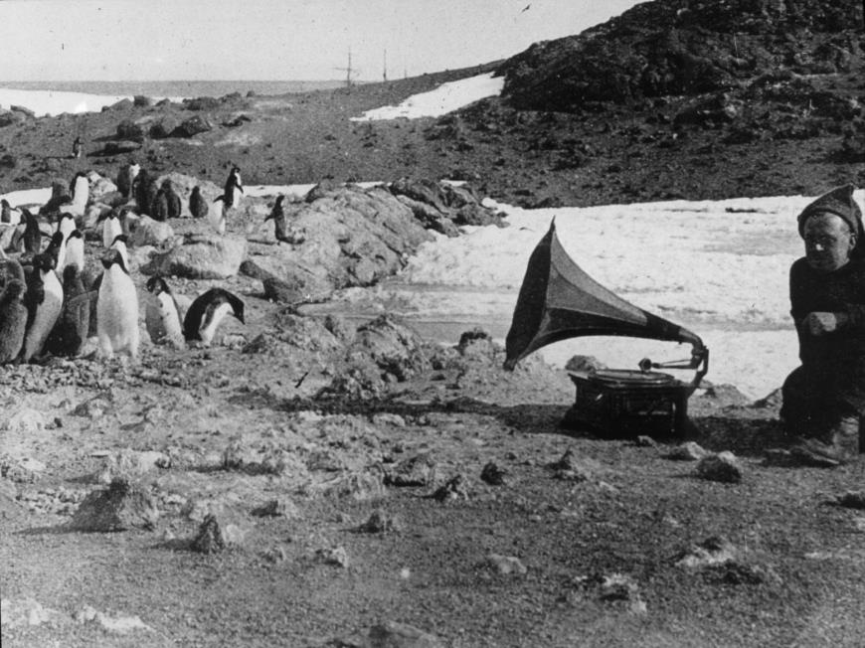
Nimrod Expedition
The team encountered many penguins.
What’s happening in these pictures?

Slide 15
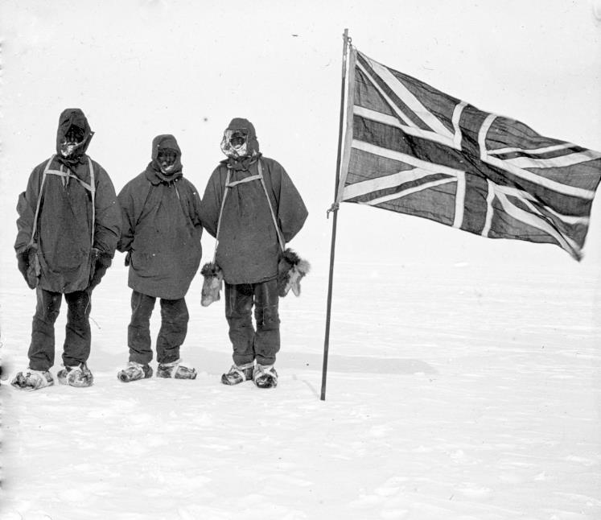
Nimrod Expedition
The Nimrod team managed to get further than Scott’s Discovery team.
However, they became very ill and didn’t have enough food to complete the mission.
They returned home before reaching the South Pole.
How do you think they felt about abandoning the mission?

Slide 16
Terra Nova Expedition
In 1910, Robert Scott set off on another expedition to reach the South Pole.
On the way to Antarctica, the ship encountered several problems.
Another explorer, Amundsen, had sent Scott a telegram. In it, he explained that he was also going to the South Pole!
The ship was struck by a storm. The crew had to use buckets to stop water from flooding in and sinking the ship.
The ship then ran into ice that it couldn’t sail through. They were delayed by 20 days.
Scott

Slide 17
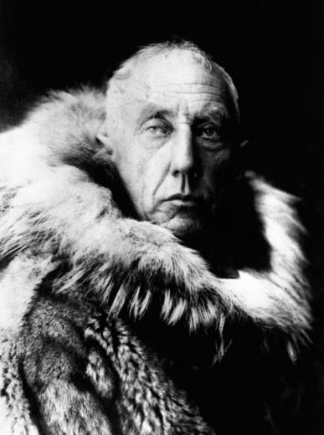
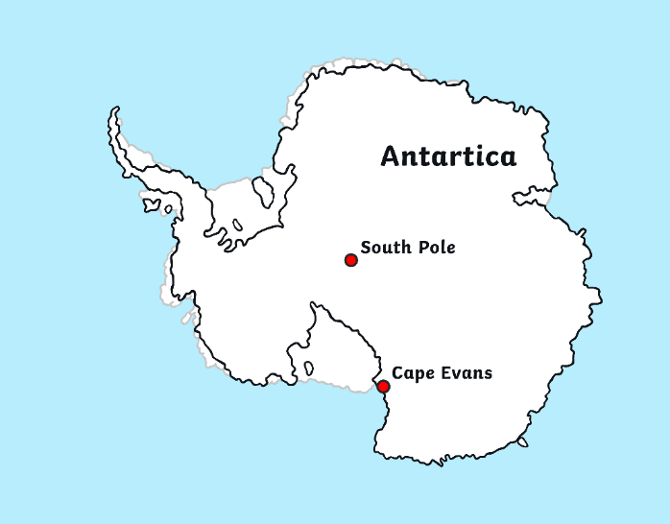
Terra Nova Expedition
In 1911, the Terra Nova team set up a hut on Antarctica in a place that they named Cape Evans.
Amundsen
It was while doing scientific research that the team found out that the rival explorer, Amundsen, was camped on Antarctica too!

Slide 18
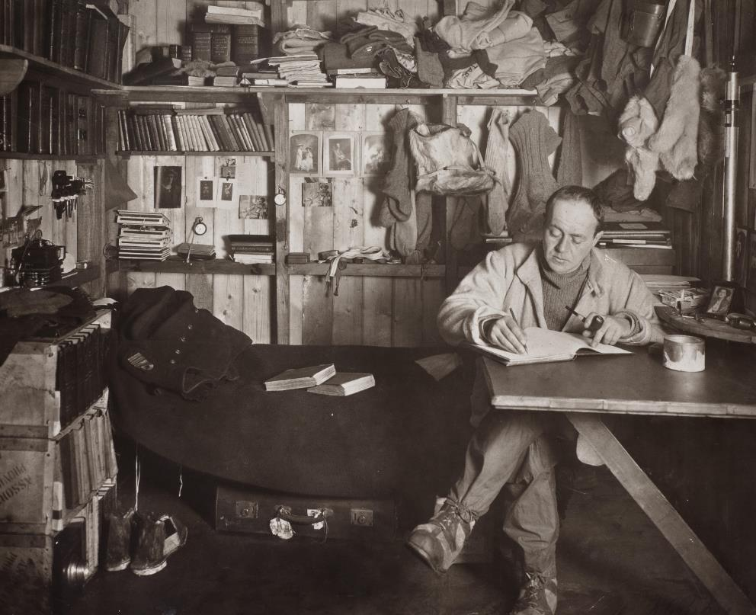
Terra Nova Expedition
There was now a clear race to reach the South Pole.
Scott wrote in his diary that he was going to carry on as usual, ignoring Amundsen and his team.

Slide 19
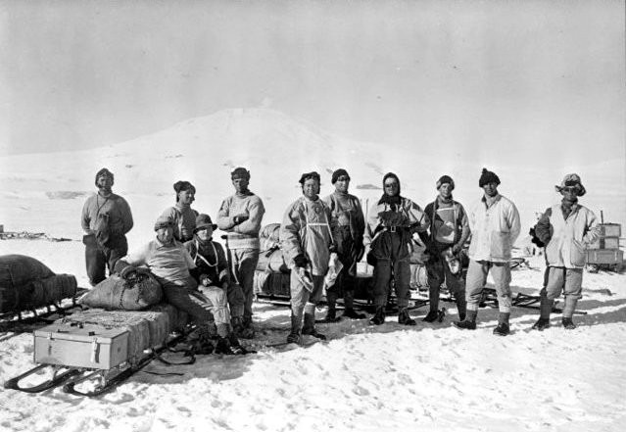
Terra Nova Expedition
In September, Scott set out to reach the South Pole.
He initially set out with a group of 12 men.
Along the way, some of the crew returned to base.
Eventually, it was a final team of five that completed the whole mission:
Scott, Wilson, Oates, Bowers and Evans

Slide 20
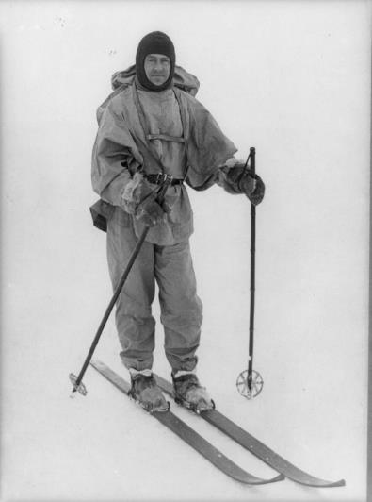
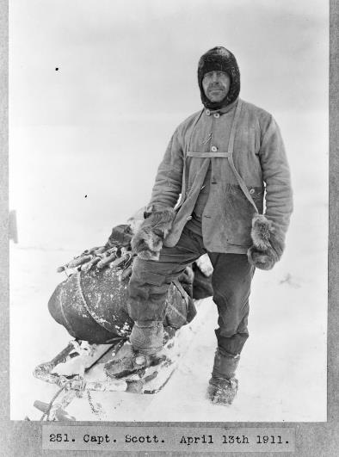
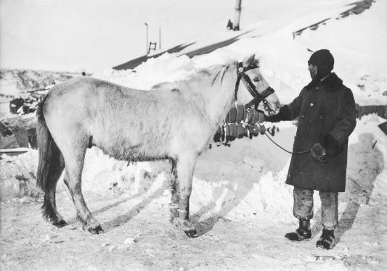
Terra Nova Expedition
The Terra Nova team travelled over the ice and snow on foot, on skis, on motor sledges and on sledges pulled by both dogs and horses.

Slide 21
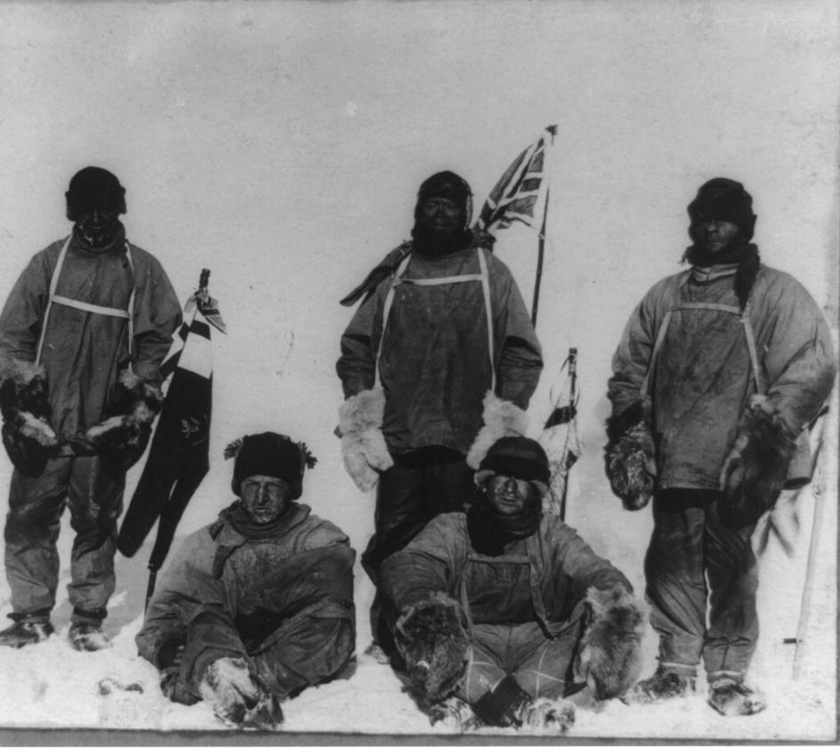
Terra Nova Expedition
In 1912, the team finally achieved their incredible goal!
The team of five men reached the South Pole and planted their British flag.
There was just one problem…

Slide 22
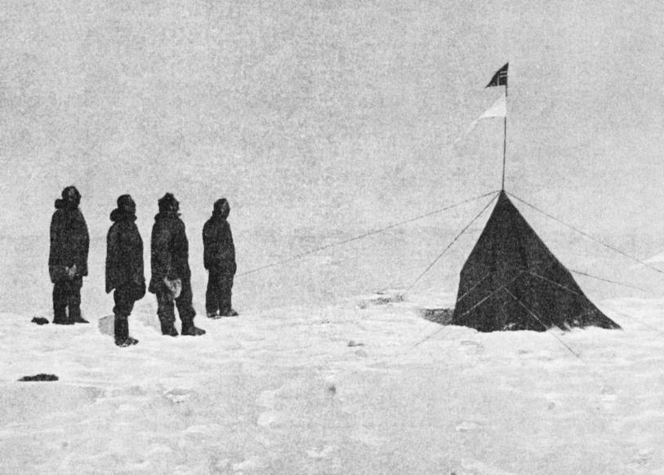
Amundsen Expedition
The Amundsen Expedition had already reached the South Pole!
Roald Amundsen, Helmer Hanseen, Sverre Hassel and Oscar Wisting were the first people to ever reach the South Pole.
They had arrived on 14th December, 1911, and planted the Norwegian flag.
They had discovered a new route to the South Pole that took them only 57 days.

Slide 23
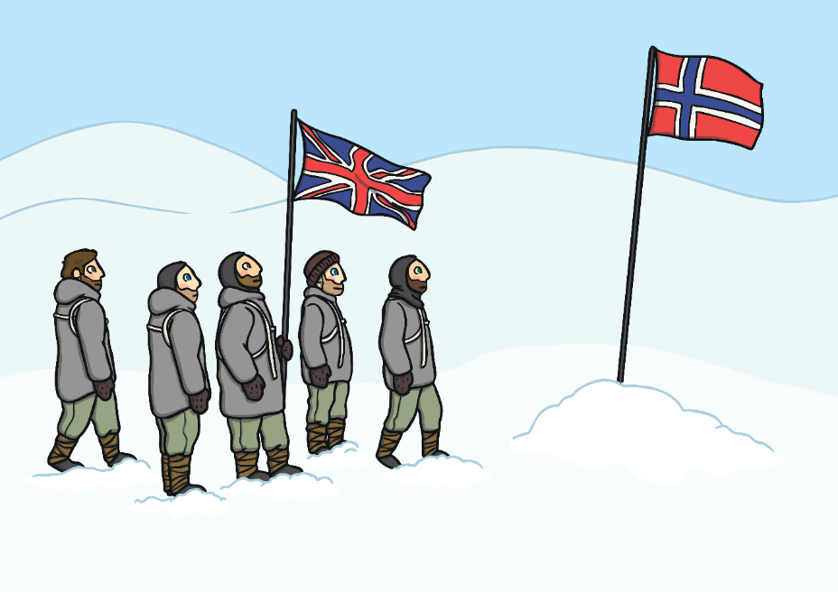
Scott’s Disappointment
It was over a month later, on 17 January, 1912, that Scott and his team reached the South Pole and discovered that the Norwegians had beaten them to it.
They were extremely disappointed.
After planting their flag, Scott’s team headed for home.

Slide 24
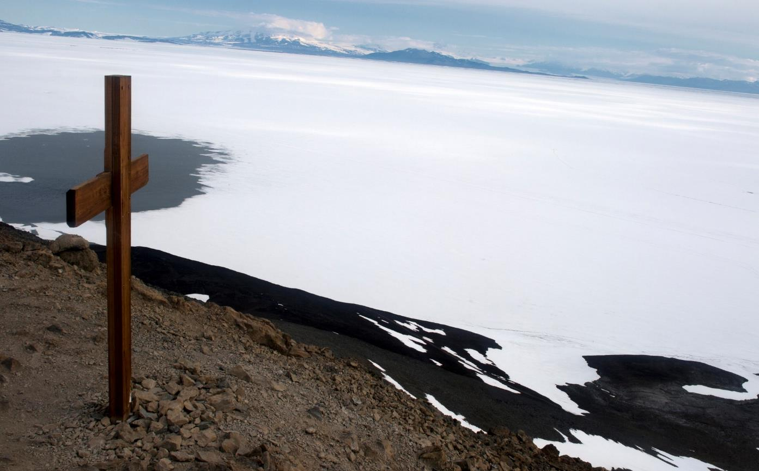
A Dangerous Mission
Scott’s Terra Nova expedition ended in tragedy. No one survived the return journey.
Later that year, a search party set out to find Scott and the Terra Nova team. They put up a cross that now acts as a memorial to these brave explorers.

Slide 25
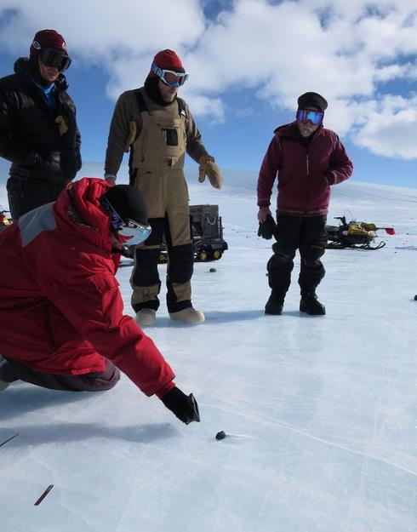
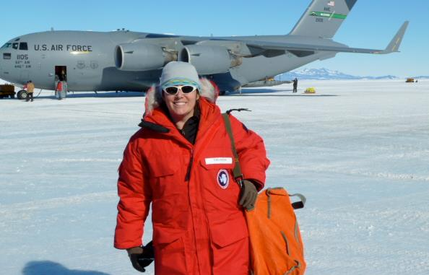
Exploring Today
Scott and Amundsen both reached the South Pole more than 100 years ago.
How do you think expeditions in Antarctica might be different today?
What do we have in the world today that might help modern explorers?

Slide 26
A newspaper report needs to…
Be about an interesting event;
Capture the reader’s attention;
Present factual information;
Be succinct and to the point;

Slide 27
The Essentials First
When the reader reads a newspaper report, they should be given the essential information first, so that they can decide if they wish to read more.
It is important that newspaper reports have the most important information coming first. This is called front-loading.

Slide 28
Structure of a newspaper report
Headline and byline
Lead
Body
Tail

Slide 29
Headline
Headline and byline
For a good headline, you need to:
Catch the reader’s attention so they want to read the rest of the report;
Sum up the story in a few words;
Use powerful and interesting language;
Write in the present tense – even if the report is about an event that has already happened;
Include alliteration or wit at times.
Lead
Body
Tail

Slide 30
Byline
Headline and byline
Lead
For a good byline, you need:
The writer’s name;
The writer’s speciality (for example, Sports reporter, Food correspondent, Crime editor, Deputy politic editor, Senior fashion reporter);
A link to the writer’s Twitter account (for example, @dgoodman).
Body
Tail

Slide 31
Lead
Headline and byline
For a good lead paragraph, you need to;
Make the paragraph short and snappy so that it briefly explains what has happened;
Ensure that, even if the reader stopped reading at this point, they would still know roughly what happened;
Use past tense in most cases;
Make sure the first paragraph answers as many of these six questions as you can –
Who? What? Where? Why? When? How?
Lead
Body
Tail

Slide 32
Body
For a good body section, you need to:
Add more information and detail to your lead paragraph;
Include background information, evidence, facts and quotes from people involved in or connected to the event/story;
Continue to write in order of importance, putting the most important information in the first few paragraphs of the body section.
Headline and byline
Lead
Body
Having quotes from witnesses or experts
will make your report more credible and interesting.
Tail
Be sure to use correct punctuation for quotes!

Slide 33
Tail
For a good tail section:
Give the reader the opportunity to gain additional information if they are particularly interested in the topic of the news report;
Include links to previous news reports or useful websites;
Include a final quote from a witness or expert that helps to sum up the story or that could hint at what might happen next.
Headline and byline
Lead
This ‘Tail’ information can be useful but is not always needed. It tends to be the least important information in the report.
Body
Tail

