Slide 2
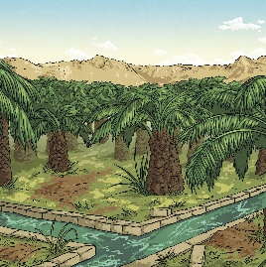
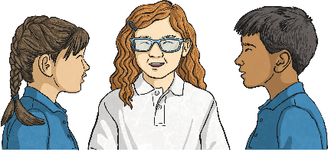



How Do We Learn about History?
Talk about it
What if you are learning
about an historical event?
Here are some ways we can learn about historical events:

Slide 3
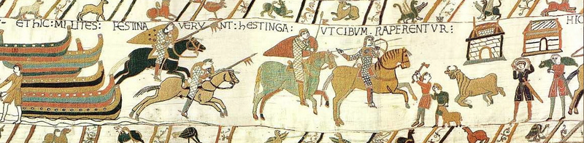
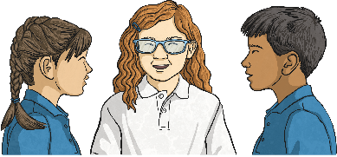
The Bayeux Tapestry
The Bayeux Tapestry gives an account of the Norman invasion of England and the Battle of Hastings. The battle happened in 1066.
Talk about it
Why do you think the story of a
famous battle was told in this way?

Slide 4
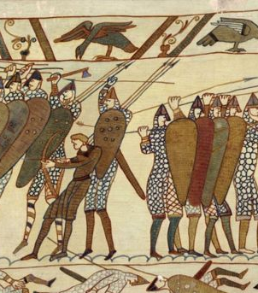
The Bayeux Tapestry
At the time the tapestry was created, very few people could read. Books were rare, as each one had to be written by hand. A tapestry told the story in a way that everyone could understand.
tapestry – Textile art made using weaving stitches.

Slide 5
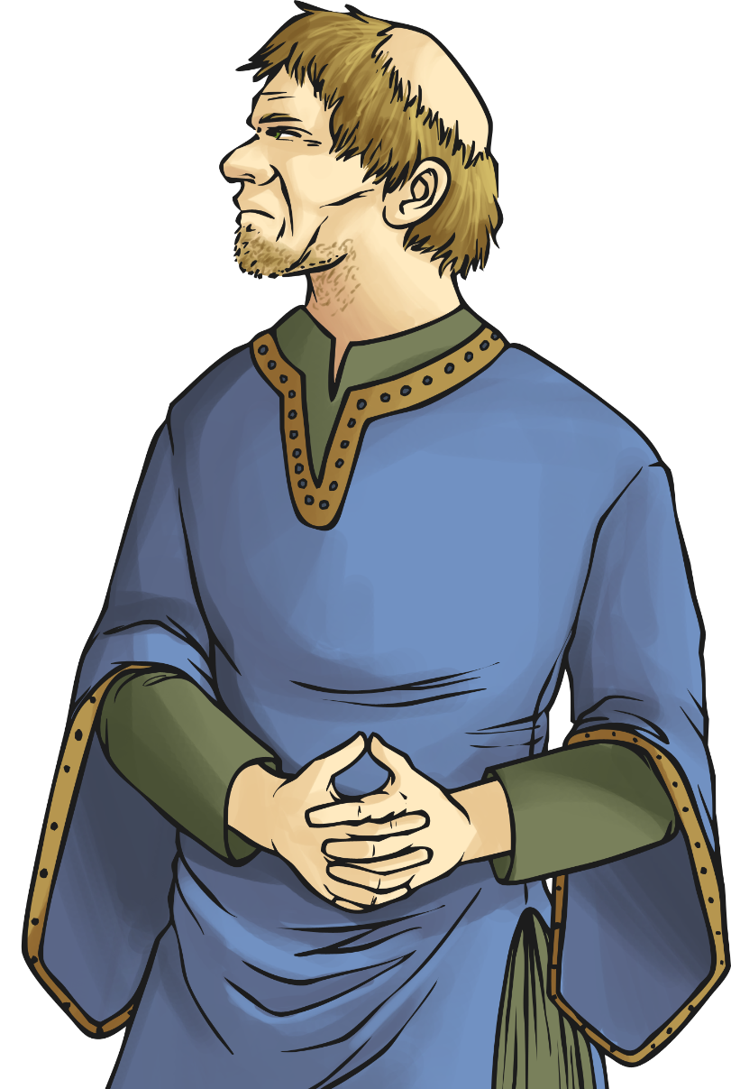
The Background to the Norman Invasion
Talk about it
Just as today, England had a monarchy.
When a king or queen of the United Kingdom dies,
how is the next monarch chosen?
Usually, the eldest child of the monarch becomes the next king or queen. In 1066, the succession of a monarch wasn’t so simple.
Did You Know?
The Succession to the Crown Act 2013 made it law that the eldest child became monarch regardless of their gender.
Until this law, it was the eldest boy. A girl only became
queen if she had no brothers (as in the case of Queen
Elizabeth II).
monarch – King or queen

Slide 6
The Background to the Norman Invasion
In 1066, Edward the Confessor, King of England died. Edward died with no children. There were several people who claimed the throne was theirs:
Harold Godwinson – Harold was a powerful and rich aristocrat. Edward the Confessor chose Harold as his successor.
William, Duke of Normandy – William’s grandfather was Edward the Confessor’s uncle.
Harald Hardrada – Harald was the king of Norway. A previous king of Norway made an agreement with a previous king of England that if either of them died childless, the other would inherit the throne of the country.
In September 1066, Harald Hardrada invaded England. King Harold’s forces met him and Harald Hardrada was killed at the Battle of Stamford Bridge.

Slide 7
About the Bayeux Tapestry
The Bayeux Tapestry tells the story of the events of 1066 following
the Battle of Stamford Bridge. It is almost like a comic strip.
The tapestry is embroidered in wool on linen. It is 70 metres long and 50 centimetres high. No one is exactly sure who made it, although
most historians agree it was made in England in the 11th century.
Did You Know?
The Bayeux Tapestry is as long as seven doubledecker buses!

Slide 8
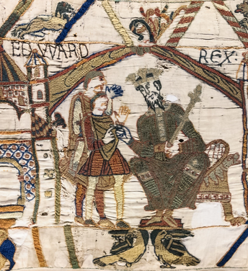
The Bayeux Tapestry Scenes
Here is Edward the Confessor selecting Harold Godwinson as his successor.
Can you see the words ‘Edward Rex’? The word ‘Rex’ is Latin for king.
Talk about it
If you had to choose a new ruler of the country, who would it be and why?
Did You Know?
The Latin word for queen is ‘Regina’. You might have seen the letters ER on post boxes. This stands for ‘Elizabeth Regina’ – Queen Elizabeth. Some post boxes have GR on them. Can you find out why?

Slide 9
The Bayeux Tapestry Scenes
Harold Godwinson was crowned at Winchester Abbey. In the picture, people are pointing upwards. Shortly before the coronation, a strange sight appeared in the sky. We know now that this was Halley’s comet. At the time, the appearance of a comet was seen as a sign that bad things were to come.
comet – A ball of ice and rock in
space. Sometimes they cause what
we call ‘shooting stars’.
Did You Know?
Halley’s comet is predicted to be seen next from Earth in 2061.

Slide 10
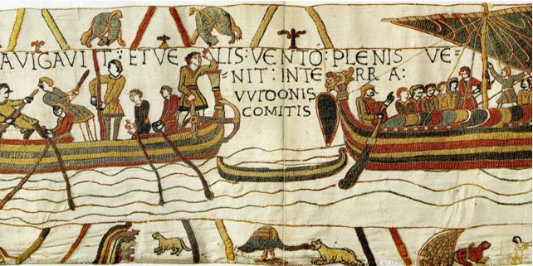
The Bayeux Tapestry Scenes
Here is William, Duke of Normandy starting his invasion of England.

Slide 11
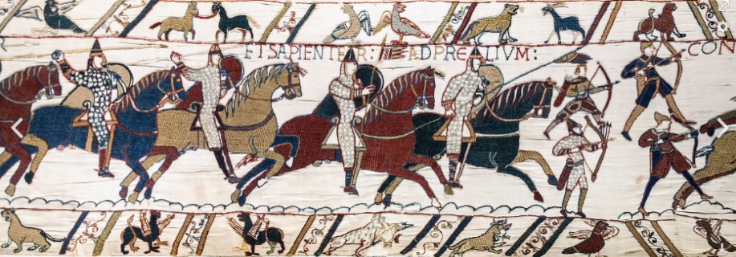
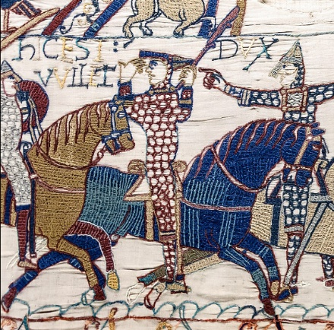
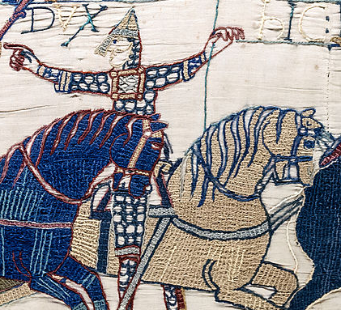
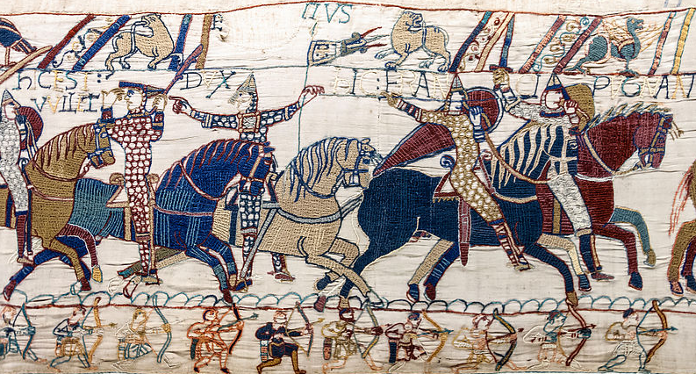
The Bayeux Tapestry Scenes
Several scenes on the tapestry show the battle. At one point,
William falls off his horse but manages to survive.
All seems to be going well for Harold until…

Slide 12
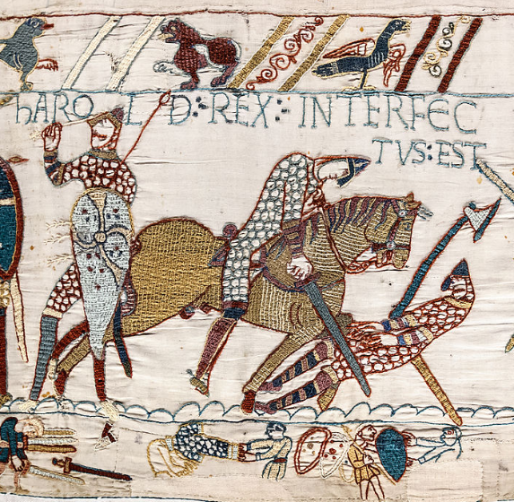
The Bayeux Tapestry Scenes
… Harold is shot in the eye with an arrow and dies.

Slide 13
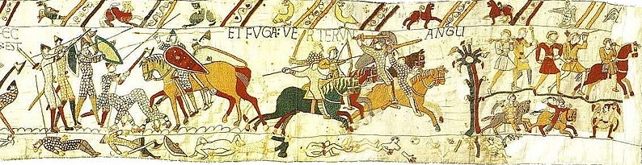
The Bayeux Tapestry Scenes
The English fighters flee the battle, with William’s men chasing them.

