Slide 1
What was life like in Anglo Saxon Britain?
By Freya Curtis😉

Slide 2
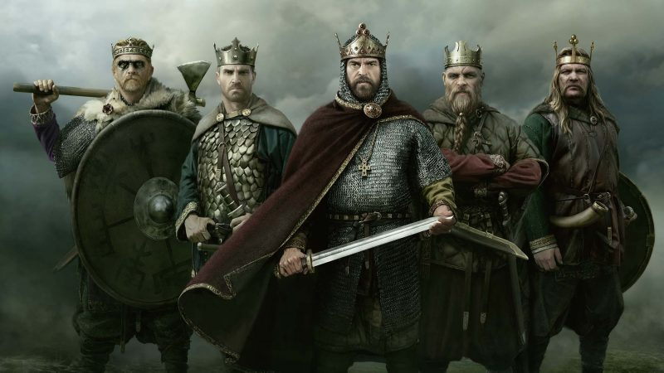
Contents
What is Anglo Saxon Britain?
What did Anglo Saxons do?
What did they wear?
What tools did they use?
Anglo Saxon names
Gallery
The end

Slide 3
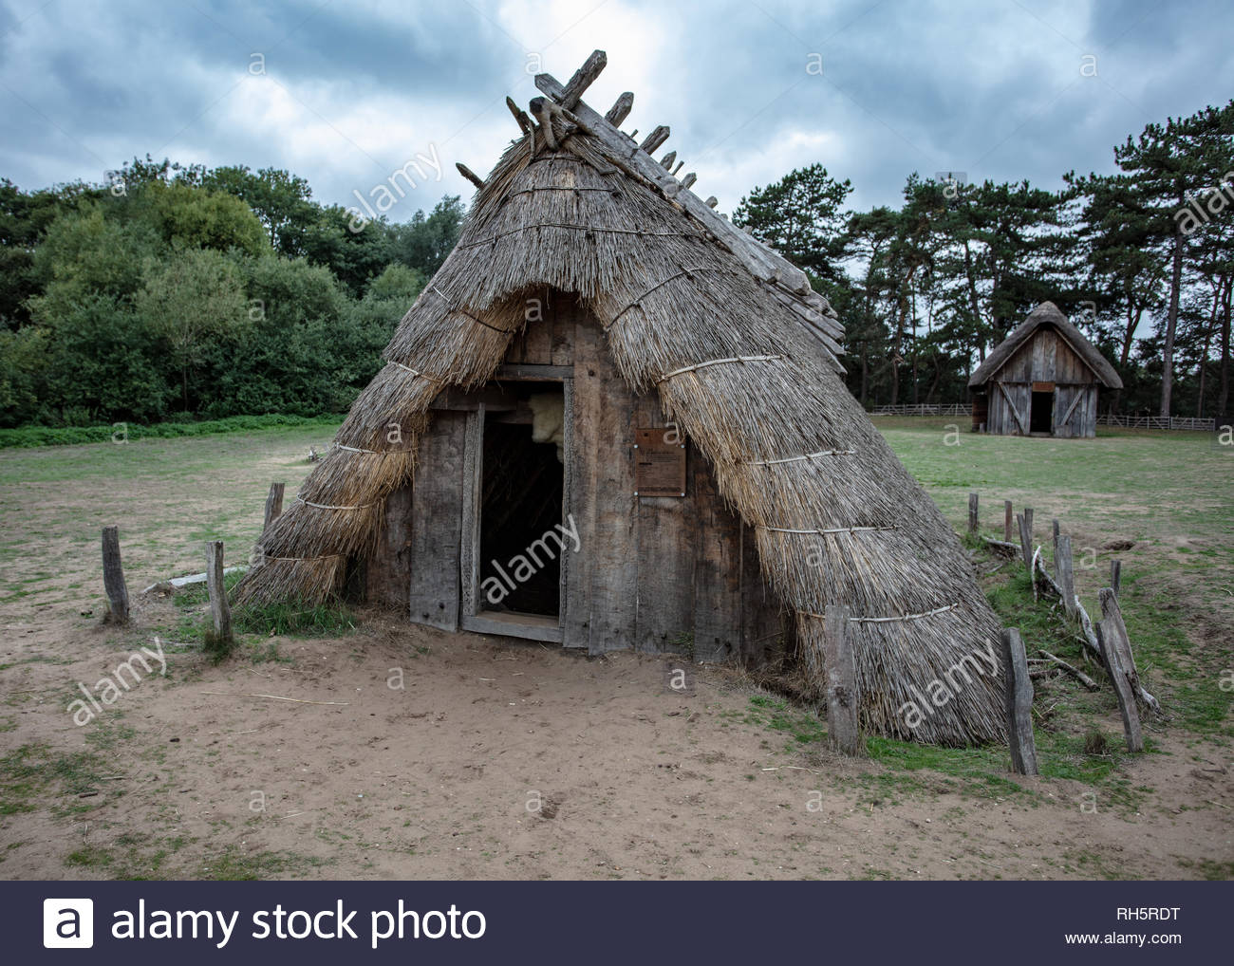
What is Anglo Saxon Britain?
Anglo Saxons were a cultural group who inhabited England from the fifth Century. It was a time of war for them and they were mostly poor because various things were not made yet. It was a hard time to live in.

Slide 4
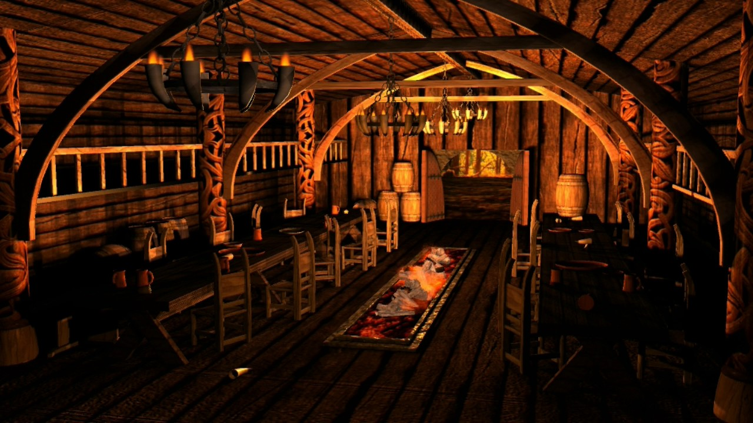
What did Anglo Saxons do?
Anglo Saxons enjoyed horse racing ,hunting feasting and music. Whilst they ate they got entertainment from people playing the harp and juggling even with knifes. They had big feasts in a hall called a Mead-hall.

Slide 5
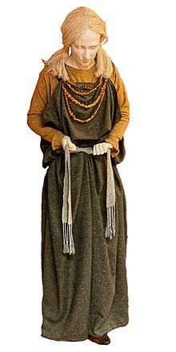
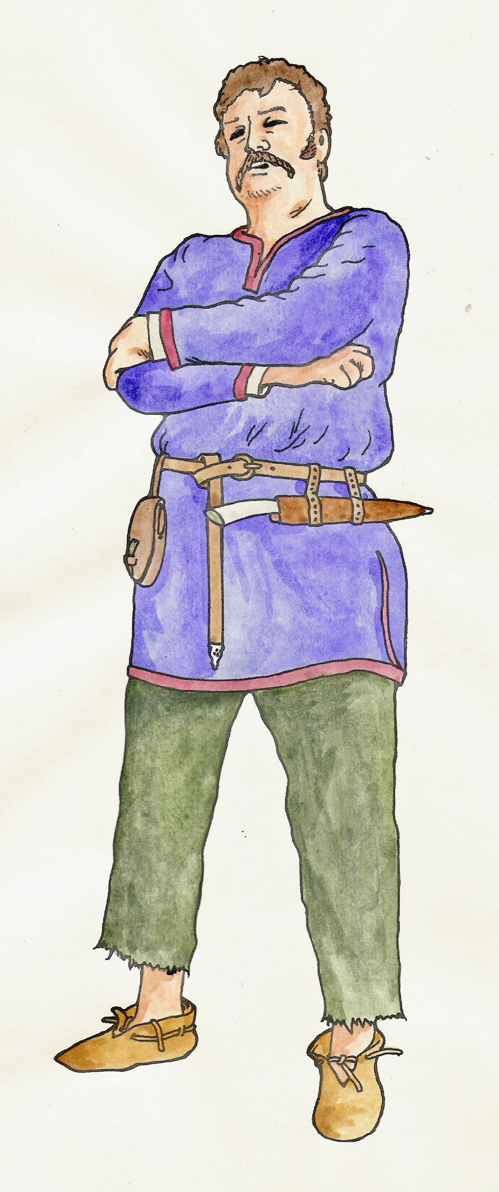
What did they wear?
Anglo Saxons made their own clothes out of their own materials. The men wore long sleeves made out of wool or linen. Anglo Saxon women wore long gowns that fastened to their shoulders with a pin or a broach. They would have been made out of wool or linen because they were the most common fabrics.

Slide 6
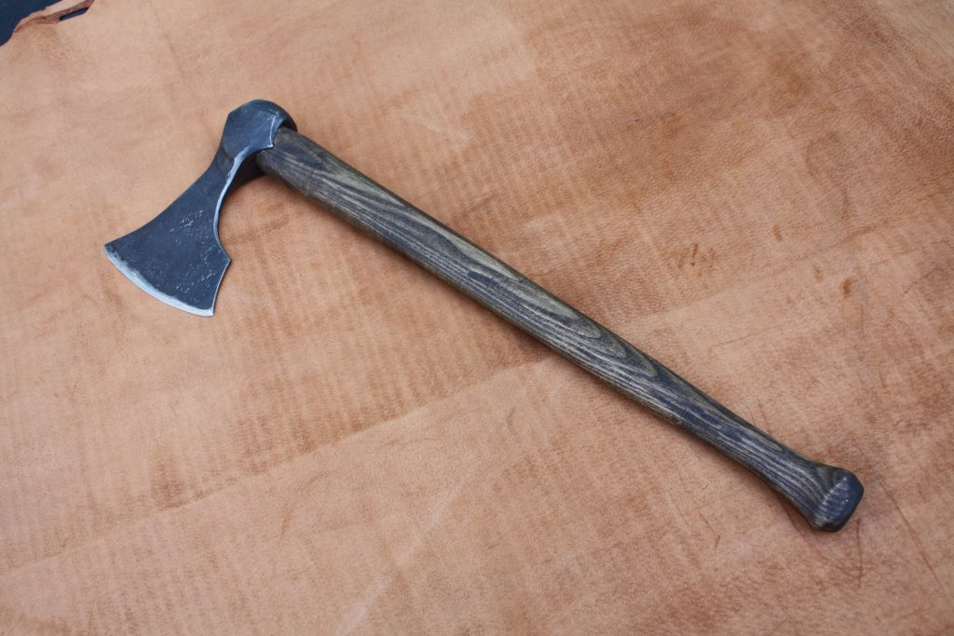
What tools did they use?
Anglo Saxons used spears for fighting and throwing. They used swords and axes. Bows and arrows. But slings were not used by the Anglo Saxons.

Slide 7
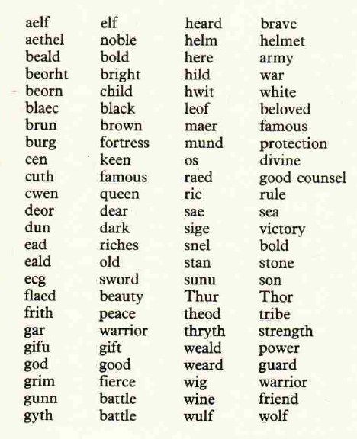
Anglo Saxon names.
Chad
Cuthbert
Edmund
Edward
Alfred
Wilfred

Slide 8
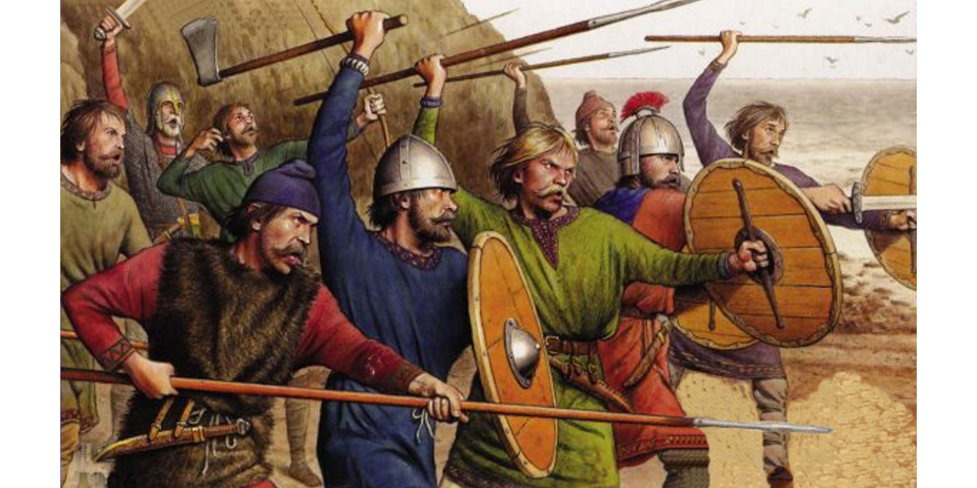
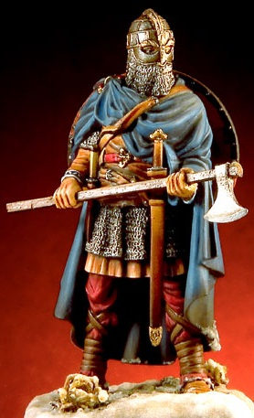
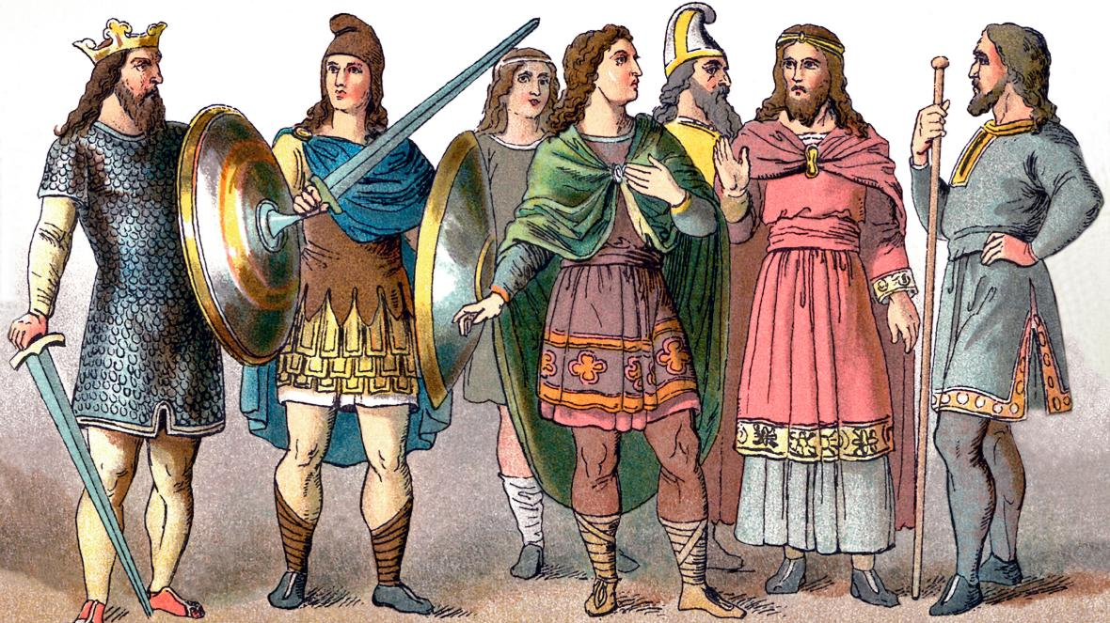
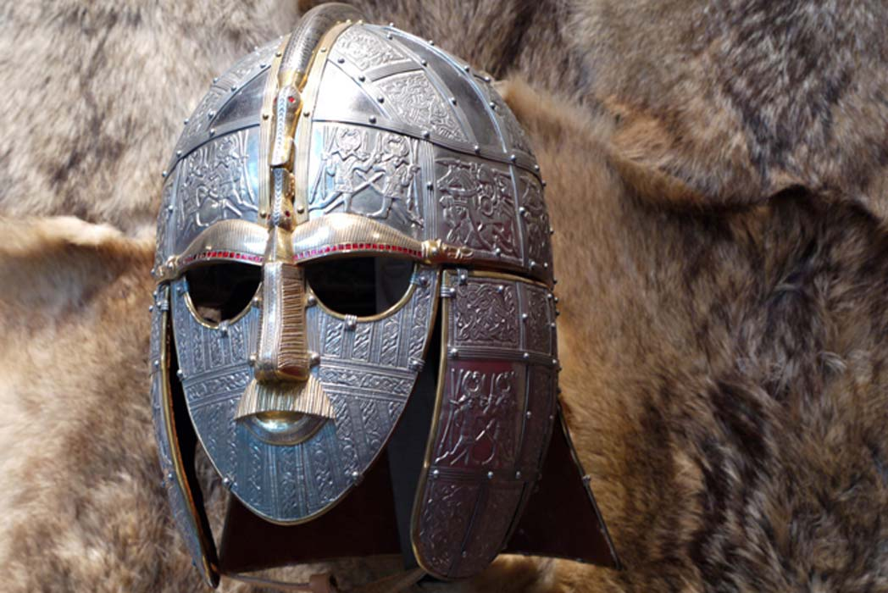
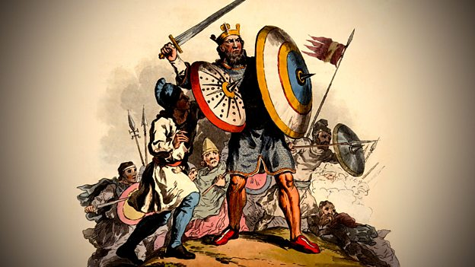
Gallery

