Slide 1
If you were a meal, what would you be?
Think about what meal you would be and explain why. Here are some familiar names to give their Philosophy Friday answers.

Slide 2
Mrs Blackaby - Lasagne
Lots going on in the inside – but always manages to turn out okay.
Can be accompanied by lots of different foods (gets along with people) has some veg in it (trying to stay healthy) is bright and colourful on the plate (cheerful).

Slide 3
Miss Gregory – Fish, chips and peas
What you see is what you get!
Traditional.
Try to eat the peas and they fly all over the place – they can’t keep still.
Just like the batter on the fish – a bit fried at times…
But like the chips, a bit mushy at times.

Slide 4
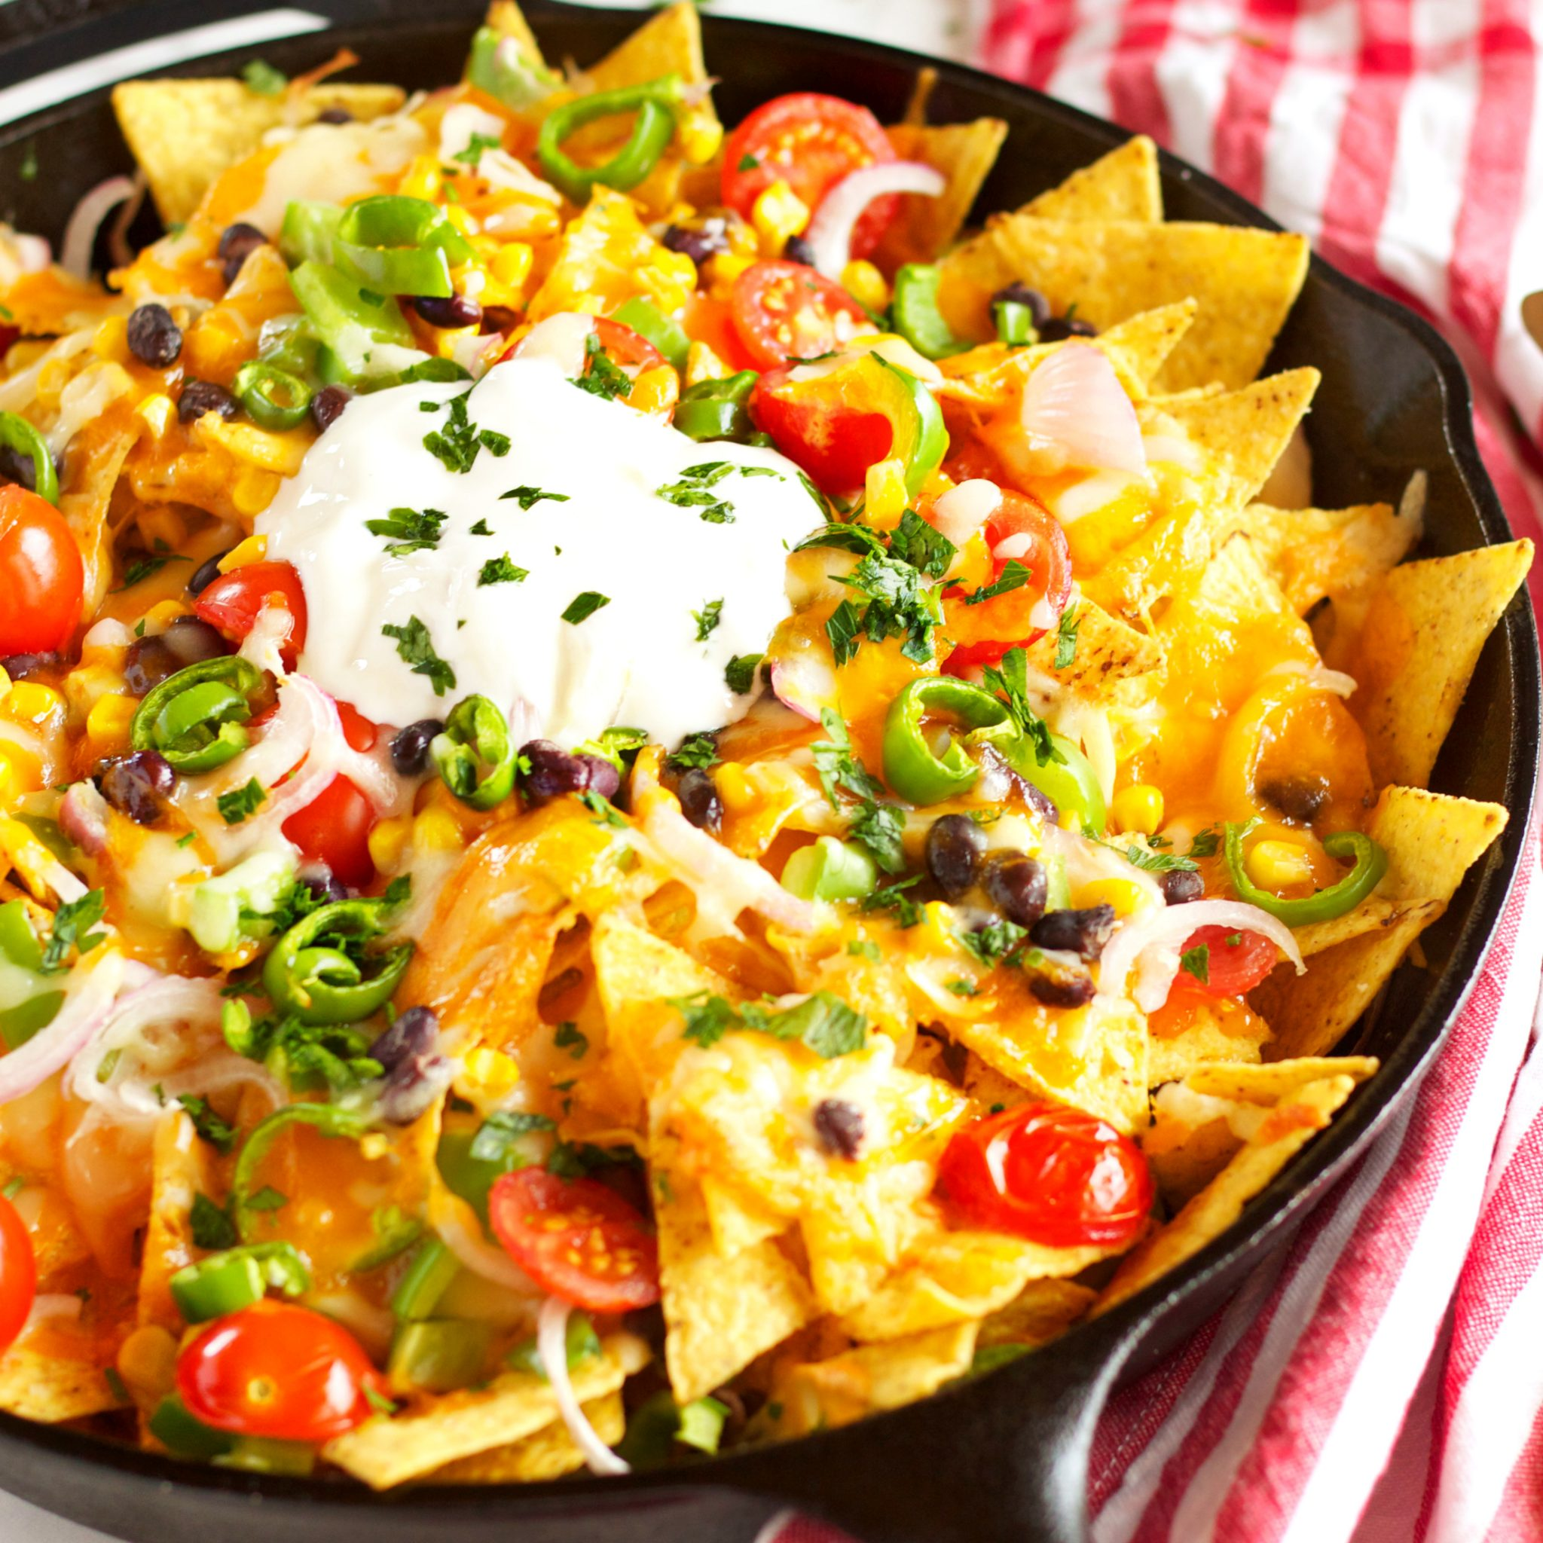
Miss Webster – Nachos
A social meal usually enjoyed with family and friends
An eclectic mix of flavours – a bit like my taste in music
Bright and colourful ☺
Very cheesy – a bit like my jokes:
What do you call a dinosaur made of cheese?
Gorgonzilla!

