Slide 1
The British slave trade
1562 - 1807

Slide 3
What was the slave trade?
The slave trade was where people bought gunpowder and brandy and sold it to the Africans in exchange for black people.
They then took the Africans by boat and sailed to America and sold them for sugar and rum.
Then they went back to England and sold it.
This was called the slave trade triangle.
The slaves were treated very badly and millions died.

Slide 4
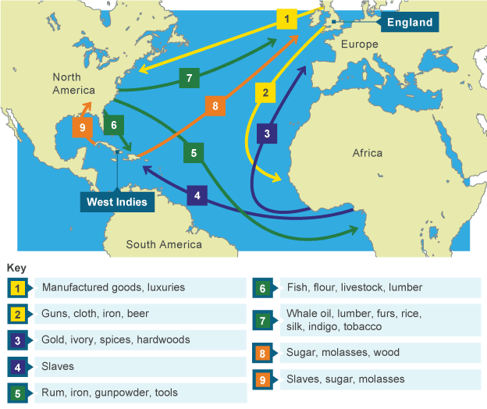
This picture shows the trade triangle and what was traded in each country.

Slide 5
How did the slave trade start?
John Hawkins is thought to be the first English slave trader.
He left England in 1562 on the first of three slaving voyages.
In 1563 he sold slaves in St Domingo.
His second voyage was in 1564 and his final, and disastrous voyage was in 1567.
Business men realised they could make a lot of money from selling people and a slave would sell for £20 which was a lot of money in those days.

Slide 7
What is a slave?
A slave is someone who is forced to work for somebody else usually without getting any pay.
They are often treated very badly and often get badly hurt by the people they work for.

Slide 8
Why was the slave trade so awful?
It means you are owned by someone else.
People make money from buying or selling the slave.
A lot of slaves died or were hurt and badly treated.
The slaves were taken away from their home and their family

Slide 9
When did the slave trade finish?
William Wilberforce said it wasn’t right for people to own people and tried to stop the slave trade.
In 1807 it became illegal to trade in people.
Sadly people are still made into slaves today even though it is against the law in England.
This is called modern day slavery.

