Slide 1

May Day
By Daisy

Slide 2
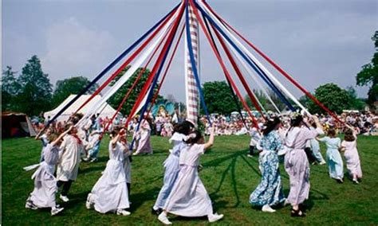
Contents
What is May Day?
What is the History behind it?
Morris Dancing
Maypole Dancing
May Queen
How to celebrate May Day in Lockdown
Any Questions
The End

Slide 3

What is May Day?
May Day is Celebrated on the 1st of May hence the name
. The Pagan name for May is Beltane which means, ‘the day of fire’ which marks the coming of Summer
. Throughout the world, May Day is recognized as ‘International Workers Day’ (IWD)
. Unlike Easter and Christmas, May Day is the one festival of the year that does not have a church service

Slide 4

What is the history behind it?
May is named for the Roman Goddess Maia
May Day has changed throughout history. In Greek and Roman times it was a day to celebrate spring and the coming of Summer. When Christianity came to Europe and England, May Day became intertwined with Easter and other Christian celebrations
In the 1900s May Day became a day to celebrate labor in many communist and socialist countries. They would celebrate the workers as well as the armed forces on this day. Throughout the world, this day became known as Labour Day

Slide 5
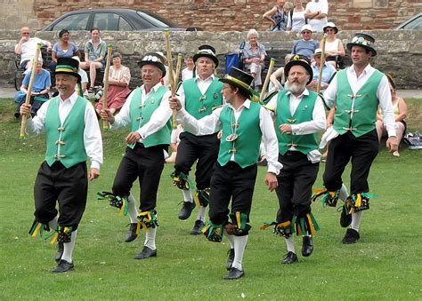
Morris Dancing
Morris dancing is also spelled Moresgue, Morrice, Morisque, or Morrisk
Men usually perform Morris Dancing
They wear bells around their arms and legs
It is celebrated on May Day

Slide 6
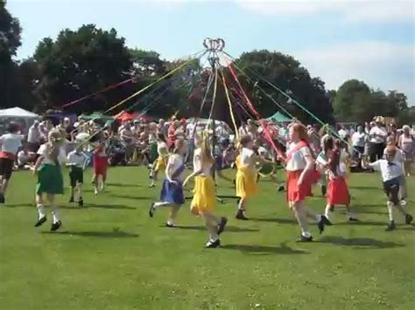
Maypole Dancing
The British tradition of dancing around a maypole is around 600 years old
Dancing around a maypole involves a group of people taking a coloured ribbon attached to it and weaving around each other to make a pattern
People often Skip around the Maypole to music
Traditionally the dancers position themselves in pairs of boys and girls before beginning their routine

Slide 7
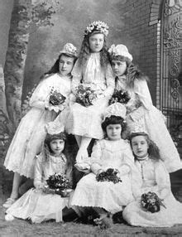
May Queen
A May Queen is a girl who rides or walks at the front of a parade for May Day celebrations. She wears a white gown to symbolise purity and usually a tiara or crown. Her duty is to begin the May Day celebrations. She is generally crowned by flowers and makes a speech before the dancing begins. Certain age-groups dance around a Maypole celebrating youth and springtime.

Slide 8
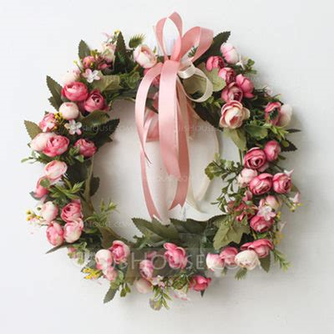
How to celebrate May Day in Lockdown
Choose someone in your family to be the May Queen
Wear a flower Crown-as a symbol of Spring turning to Summer
Bake a cake
Have a picnic in your back garden, with lots of fresh food
Make May Day cards and give them to your friends
Put bunting up around your house
Go out for your once-a-day exercise and take photographs to remember your walk/cycle/run

Slide 9


Slide 10


