Slide 1
Emperor penguins
A detailed fact file on emperor penguins

Slide 2
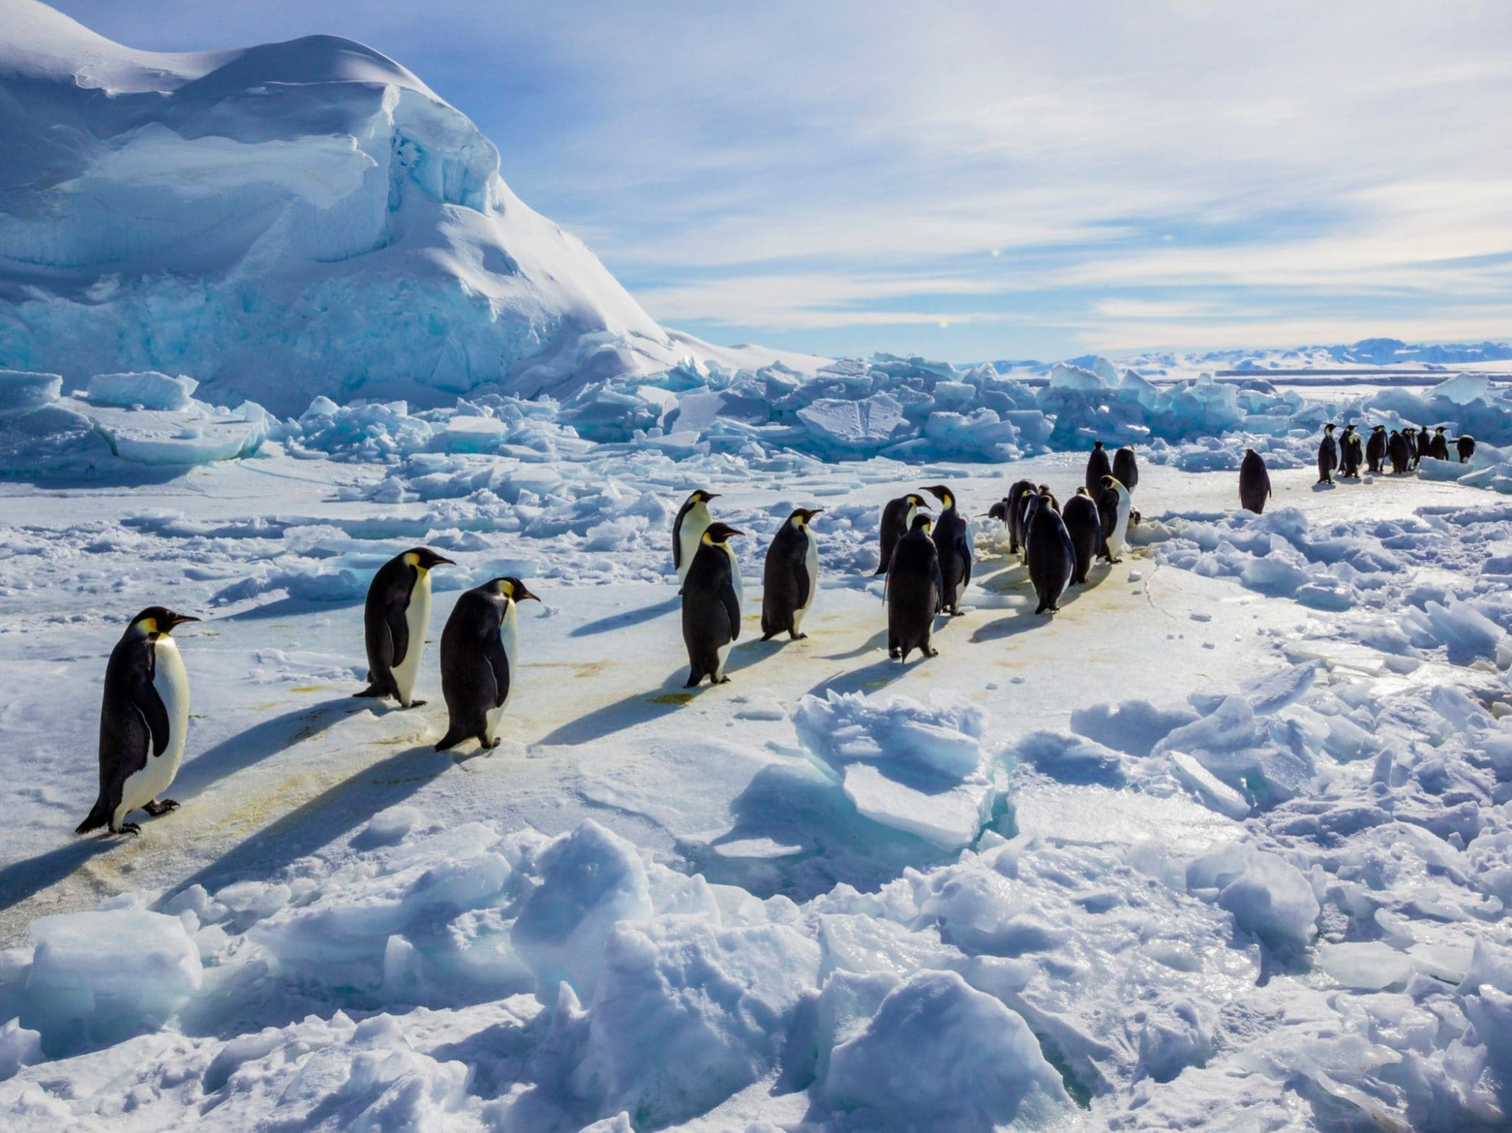
Emperor penguin breeding grounds
Emperor penguins traverse 80 metres inland to get to breeding grounds. Males arrive just before the females. The penguins get together and mate.

Slide 3
Adaptations
Emperor penguins have four layers of scale-like feathers that protect them from icy winds and provide a waterproof coat .
They can store large amounts of fat which insulates their bodies and provides a long lasting energy source.
They can dive 565 metres deep that’s deeper than any bird.

Slide 4
Adaptations
They have strong claws to grip on the ice and they use them to slide on their bellies on the ice.
The males huddle to keep warm with the eggs or chicks whilst the females are fishing in the winter.

Slide 5
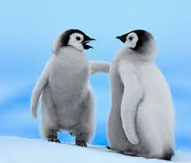
Mating part one
Emperor penguins mate and lay eggs. After the female has lain the egg the male looks after it whilst the female goes to fish for the winter. When the egg hatches the male cares for the chick until the female is back.

Slide 6
Mating part two
Then the chick, the male and the female go to the ocean and fish but not many chicks make it past their first birthday and if they survive they only live on average in the wild 15-20 years.

Slide 7
Thank you for watching
the end

