Slide 1
STARTER
What does it mean to be inspirational?
Tell someone in your household the most inspirational person in your life.
Tell them why!

Slide 2
May 2020 Inspirational People
L.O. To understand what inspires people.
1. Identify what an inspirational person is.
2. Describe some of the qualities an inspirational person has.
3. Begin to evaluate how inspirational people impact on the lives of others.
4. Write about the person who inspires you most.

Slide 3
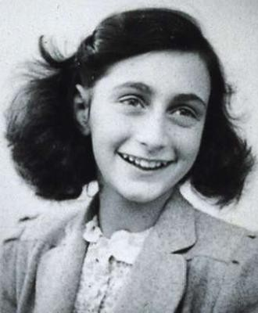
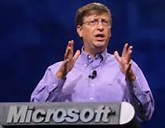
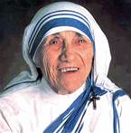
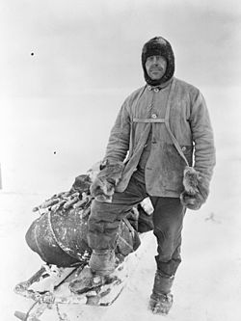
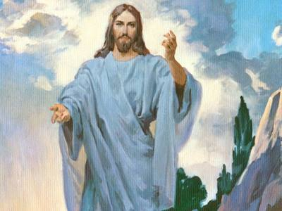
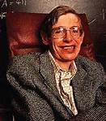
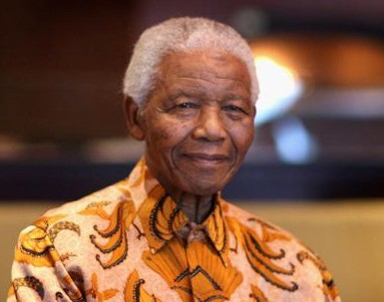
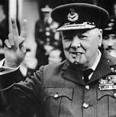
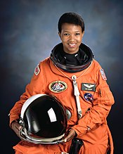
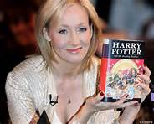
Who’s who?
Consider these pictures – why may these people be considered inspirational?

Slide 4
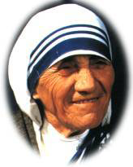
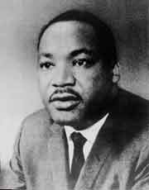
My Name is & I…..?
I am Mother Teresa.
I helped the poor and helpless in India.
I am Martin Luther King.
I was a Civil Rights Leader in America.

Slide 5
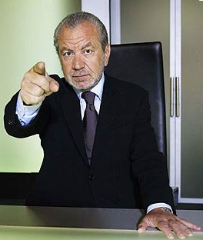
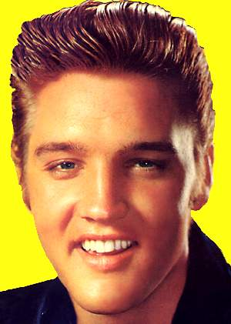
My Name is & I…..?
I am Lord Sugar.
I am a Self Made Millionaire & I am now worth around £1.15 billion.
I am Elvis Aaron Presley.
I was the King of Rock & Roll and Achieved the “American Dream”.

Slide 6
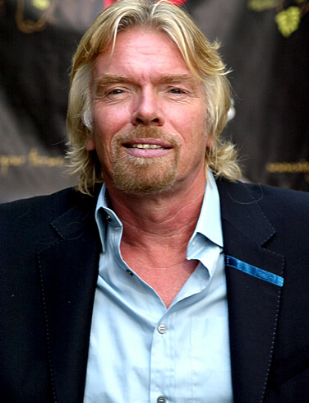
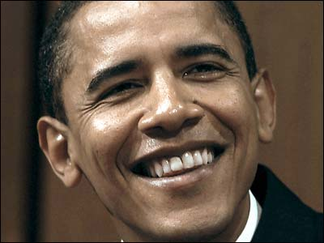
My Name is & I…..?
Sir Richard Branson
I am a Self Made Millionaire & I have dyslexia and I was told I would never achieve anything I am now worth around £790 Million.
I am Barack Obama.
I was the first person of colour to be the President of America.

Slide 7
Qualities of an inspirational person…
What qualities should an inspirational person have and why do you think this?
What qualities might all inspirational people have in common?

Slide 8

Two other inspirational people to add to our list?
Dick and Rick Hoyt are a father-and-son team from Massachusetts (USA) who together compete in marathon races. When they’re not in a marathon they are participating in a triathlon…
a daunting combination of 26.2 miles of running, 112 miles of bicycling, and 2.4 miles of swimming.

Slide 9
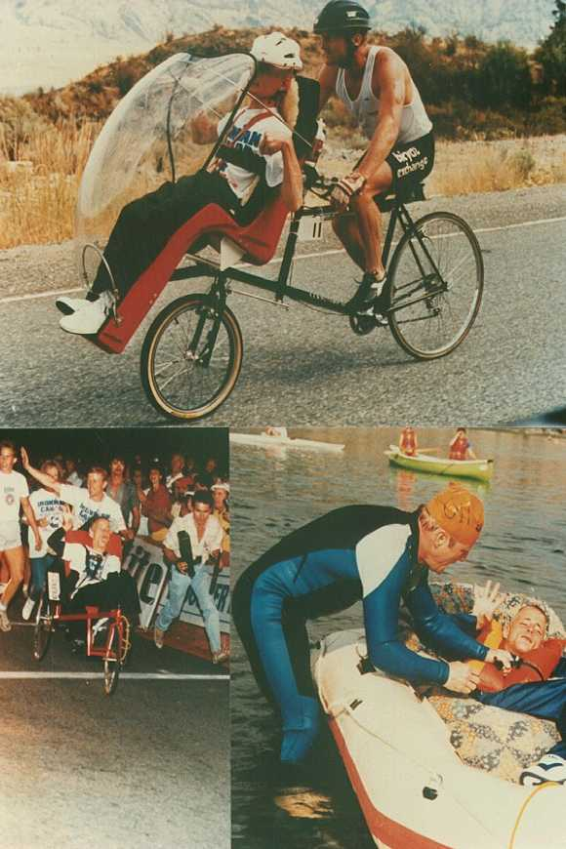
At the start of the race when Dick swims, Rick is in a small but heavy, firmly stabilised boat being pulled by Dick.
Next Dick cycles and Rick is placed in the seat-pod from his wheelchair which is then attached to the front of the bike.
Finally when Dick runs, Rick is in his wheelchair that Dick is pushing.

Slide 10
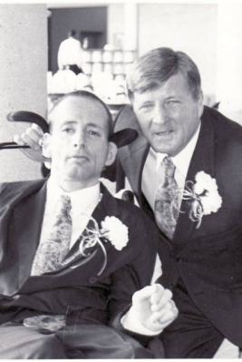
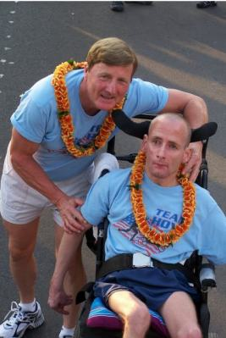
The message of Team Hoyt is that everybody can achieve their goals.”

Slide 11
Let’s watch a video of this… https://www.youtube.com/watch?v=64A_AJjj8M4 (take notes on the inspirational qualities you see)

Slide 12
What was inspirational about the Hoyt family? Which inspirational qualities did both display?

Slide 13
Things that a person may do if they have been inspired by others:
Work hard at school
Turn to faith
Work with charity
Overcome hard life issues (like the Hoyt brothers)
Be creative
Fight for human rights
Any others?

Slide 14
TASK
Choose a person who inspires you. Find out what you can about them and make notes. Write about them.
Plenary
What ideas did we come up with?

