Slide 1
Date Week beginning 15/6/2020
Time Zones
L.O To be able to understand different time zones.
S.C:
Identify what GMT means
Explain why we have time zones
Locate countries with more than one time zone

Slide 2
Key Terms
Time zone - A range of longitudes where a common standard time is used.
Longitude – The angular distance of a place east or west of the Greenwich meridian.
Greenwich meridian – The prime meridian which passes through the Royal Observatory at Greenwich in London. In 1884 it was adopted internationally as the zero of longitude.
Meridian – A circle of constant longitude passing through a given place on the earth’s surface and the terrestrial poles.

Slide 3
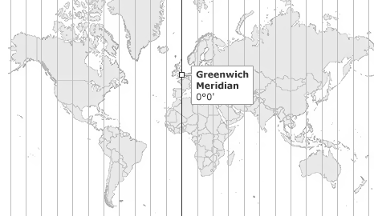

Slide 4
Why do we need to have different time zones?
Why can’t it be 8pm at the same time across the world?

Slide 5
Scottish-born Canadian Sir Sandford Fleming proposed a worldwide system of time zones in 1879. He advocated his system at several international conferences, and is thus credited with the instigation of "the initial effort that led to the adoption of the present time meridians." In 1876, his first proposal was for a global 24-hour clock, conceptually located at the centre of the Earth and not linked to any surface meridian. In 1879 he specified that his universal day would begin at the anti-meridian of Greenwich (180th meridian), while conceding that hourly time zones might have some limited local use. He also proposed his system at the International Meridian Conference in October 1884, but it did not adopt his time zones because they were not within its purview. The conference did adopt a universal day of 24 hours beginning at Greenwich midnight, but specified that it "shall not interfere with the use of local or standard time where desirable".

Slide 6
By about 1900, almost all time on Earth was in the form of standard time zones, only some of which used an hourly offset from GMT. Many applied the time at a local astronomical observatory to an entire country, without any reference to GMT. It took many decades before all time on Earth was in the form of time zones referred to some "standard offset" from GMT/UTC. By 1929, most major countries had adopted hourly time zones.

Slide 7
Today, all nations use standard time zones for secular purposes, but they do not all apply the concept as originally conceived. North Korea, Newfoundland, India, Iran, Afghanistan, Burma, Sri Lanka, the Marquesas, as well as parts of Australia use half-hour deviations from standard time, and some nations, such as Nepal, and some provinces, such as the Chatham Islands of New Zealand, use quarter-hour deviations. Some countries, such as China and India, use a single time zone even though the extent of their territory far exceeds 15° of longitude.

Slide 8
Think and discuss;
Why would some countries have more than one time zone? Have a think, see if the next slide helps you answer the question?

Slide 9
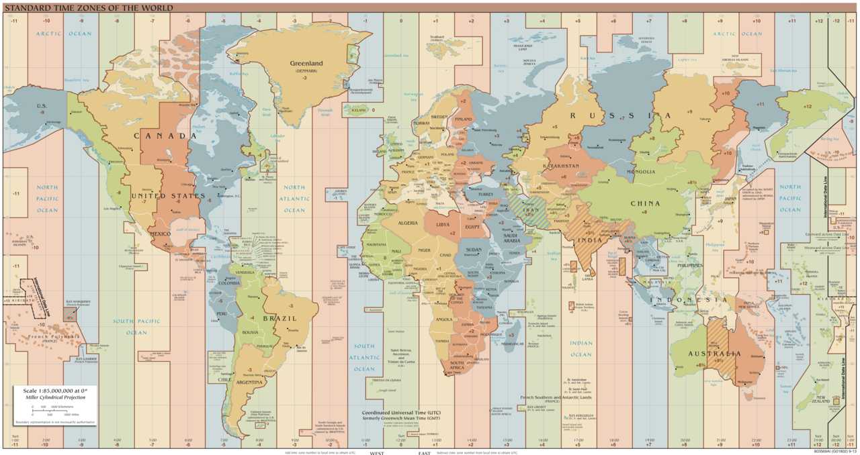

Slide 10
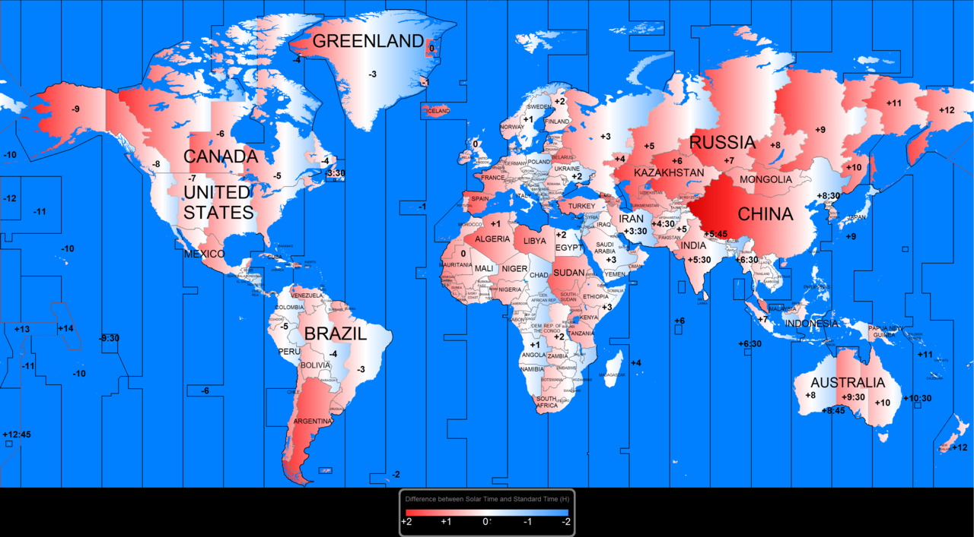

Slide 11
Activity Time.
What time is it now? Work out the time difference for the countries below:
Egypt
India
Japan
Peru
Italy
Russia
Canada
Australia

Slide 12
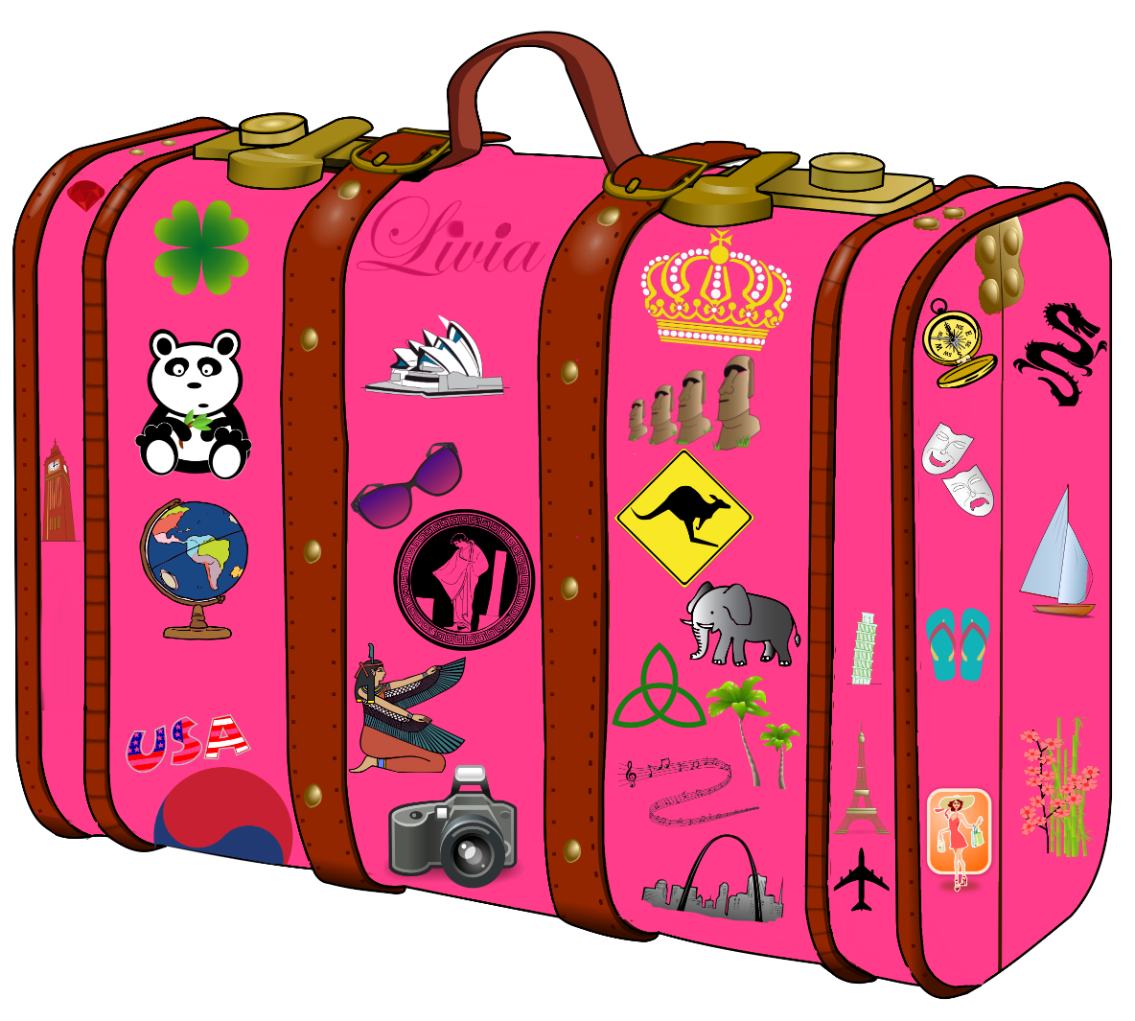
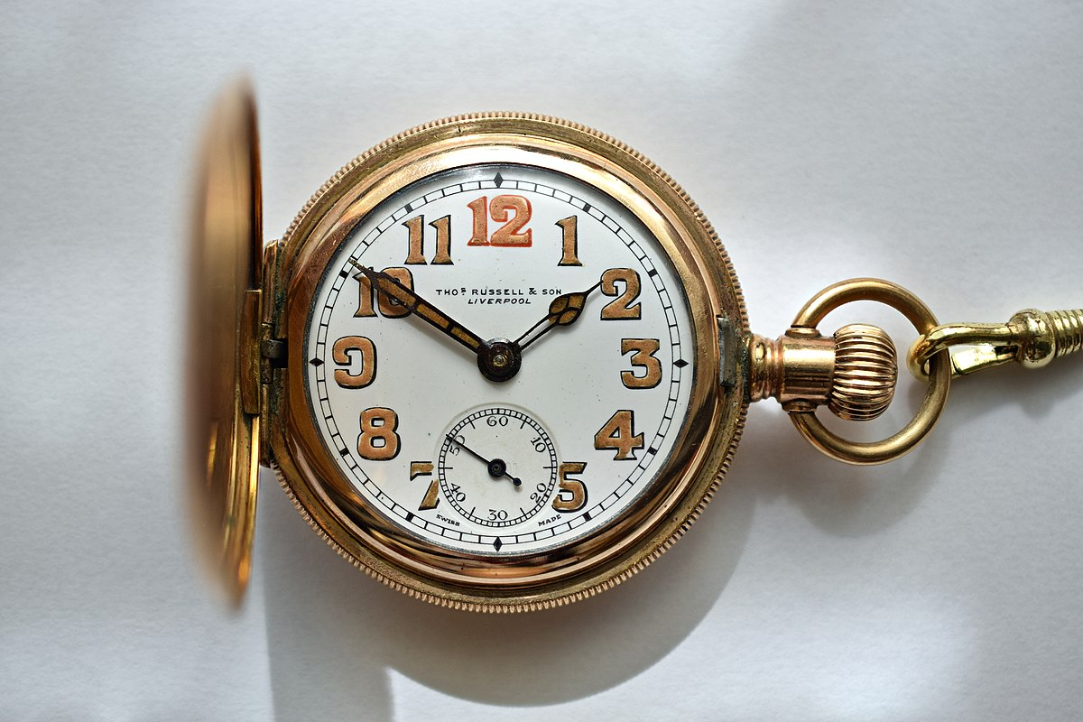
Task 2
Choose a country that you find interesting. (Needs to be one in a different time zone).
Write down some different tasks you do at different times of the day.
What time would it be at those points in the day of you were living in your chosen country?
What might you be doing instead?
This Photo by Unknown Author is licensed under CC BY-NC

