Slide 1
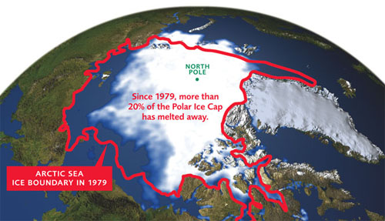
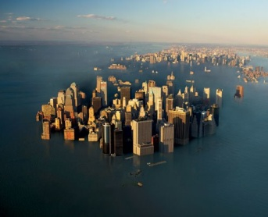
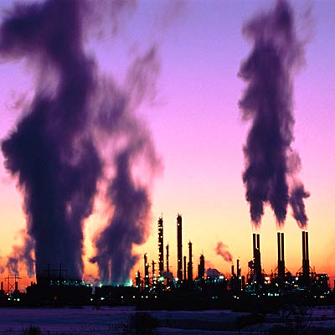
Antarctica and the Arctic: The Effects of Humans
What effect COULD global warming have?
What things cause global warming?

Slide 2
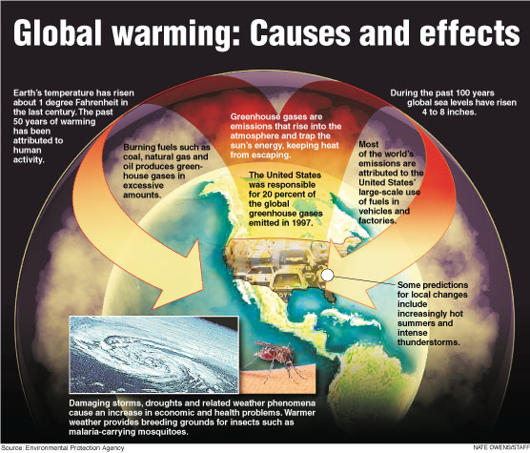
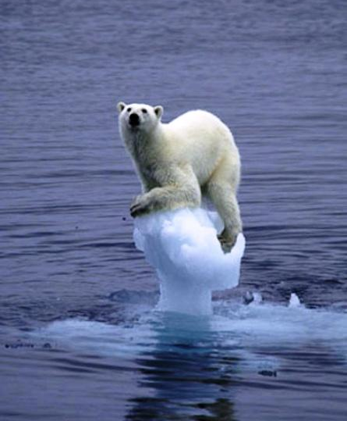
Antarctica and the Arctic: The Effects of Humans
What effect does Global warming have on the animals around the ice caps?

