Slide 1
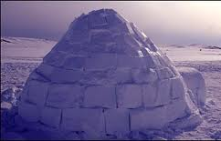
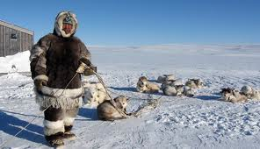
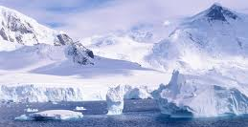
Inuits

Slide 2
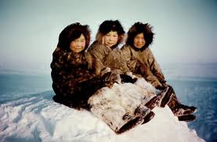
Inuit people
Many groups of people live in the Arctic. The largest group of people in the Arctic are the Inuit community. They live along the coast and hunt seal, caribou and whales. They also eat fish. The Inuit used to be known as Eskimos.

Slide 3
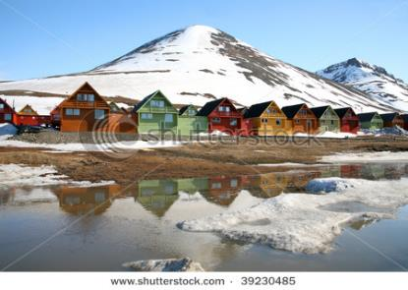
Where they live
They live in small communities where there are shops, churches and schools. The larger communities have small hospitals to care for the sick. They watch television and play video games. Children go snowmobiling, skating, snowboarding, ice fishing and play hockey and ski. Why do you think they are colourful? (Think about the weather/ light?)

Slide 4
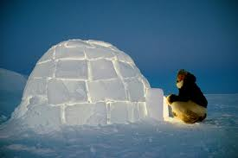
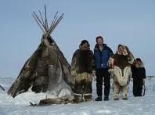
Their homes
Some people don’t live in one place all year round, but travel long distances. They do this to find better food supplies, water or better weather. They either carry their homes with them or build homes in places where they decide to settle for a while. Igloos (in the winter) and tents (in the summer) are used for shelter on hunting trips

Slide 5
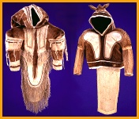
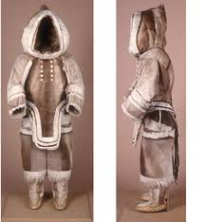
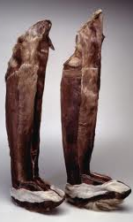
How do they live in the cold?
People must dress very warmly in the winter because of the cold winds. They wear long parkas that reach down to their knees. Mothers can keep babies warm inside the large hoods of their parkas. Most of the clothing is bought from a store, but some still wear the traditional (old ways) clothes when they go out on the land.

Slide 6
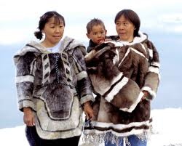
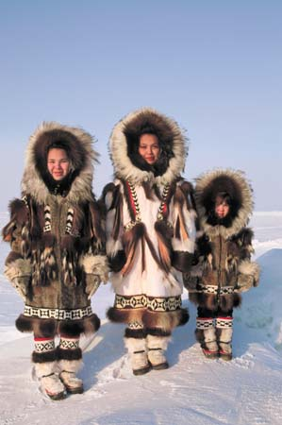
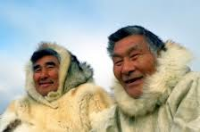

Slide 7
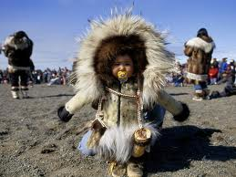

Slide 8
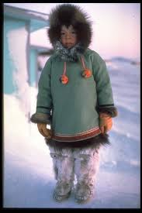
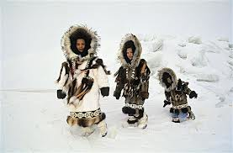
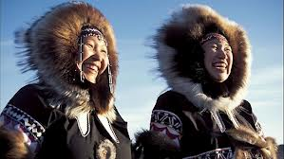

Slide 9
Your Turn . . .
Find out about one type of home used for living in the Arctic. Gather as much information as you can.
Present your findings in any way you wish.
Maybe draw a picture and add information? Make a booklet to accompany a model? Let your creative side run wild.
We look forward to seeing what you can come up with.

