Slide 1
Descriptive writing Similes and metaphors

Slide 2
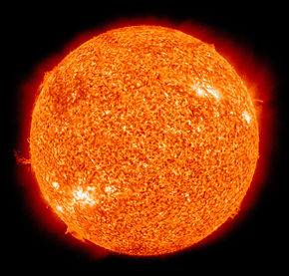
Look at these similes describing the sun. Think about which one you like best.
The sun is like a pool of golden snakes glistening in the sky, slithering in circles.
The sun is like a ball, yellow and shining.

Slide 3
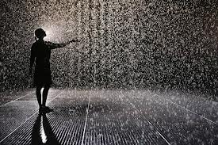
A simile is when you compare something to another thing that has a similar quality using the word like or as.
Copy and complete the following sentences:
The rain sounded like _____________ .
The wind whistled like ____________ .
The sun was as hot as ______________ .
The beautiful snow glistens like ____________ .

Slide 4
Year 3 and 4 activity Watch this link from Bitesize: https://www.bbc.co.uk/bitesize/topics/zfkk7ty/articles/z9tkxfr Have a look at these well-known similes and write your own newer ones:
Well-known simile:
As happy as a pig in mud.
As fresh as a daisy.
As cool as a cucumber.
As busy as a bee.
As clean as a whistle.
As flat as a pancake.
As quick as a wink.
As snug as a bug in a rug.
My own simile:
As happy as ________
As fresh as__________
As cool as _________
As busy as __________
As clean as _________
As flat as ________
As quick as _________
As snug as ________

Slide 5
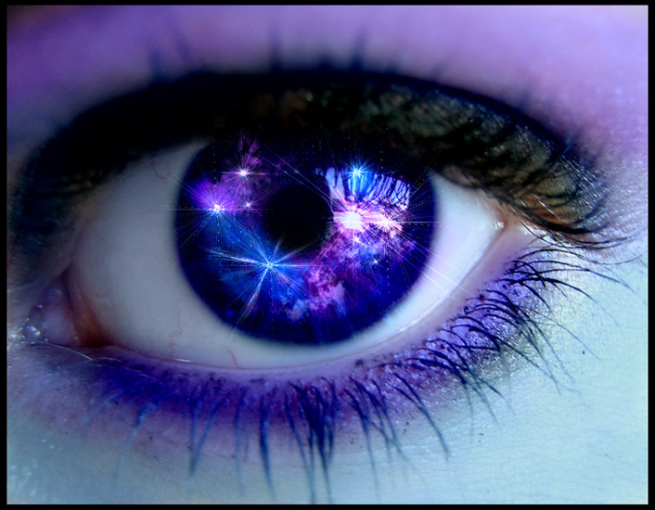
(Simile) Her eyes shone like diamonds. = (Metaphor) Her eyes were diamonds.

Slide 6
Quick thinking! Simile or metaphor
The boss’s words were crystal clear.
She was as white as a ghost.
He was a man mountain.
The baby was an octopus grabbing everything.
The bar of soap was like a slippery eel.
He was as busy as a beaver.
She was brave like a lion.
The screaming noise was a knife in my ears.
The thunder beat across the sky like a drum.
The rain was ice trickling down my face.

Slide 7
Years 5 and 6 activity
Change these metaphors to similes and add to your table by adding “like” or “as” somewhere.
The mushrooms have silver hats on.
My wife is a mouse.
Nurses are the backbone of hospitals.
Change these similes to metaphors by removing like or as and then add to your table.
Hope is like a guide through miserable nights.
I’m like a bird I always fly away.
Life is like a box of chocolates.

Slide 8
L.O I can write similes and metaphors
Think about yourself. Describe how you feel, using a simile or metaphor:
When you wake up.
When you a re angry.
When you are sad.
When the weather is sunny.
When it is rainy or cold.
When you hear a noise in the night.

