Slide 2
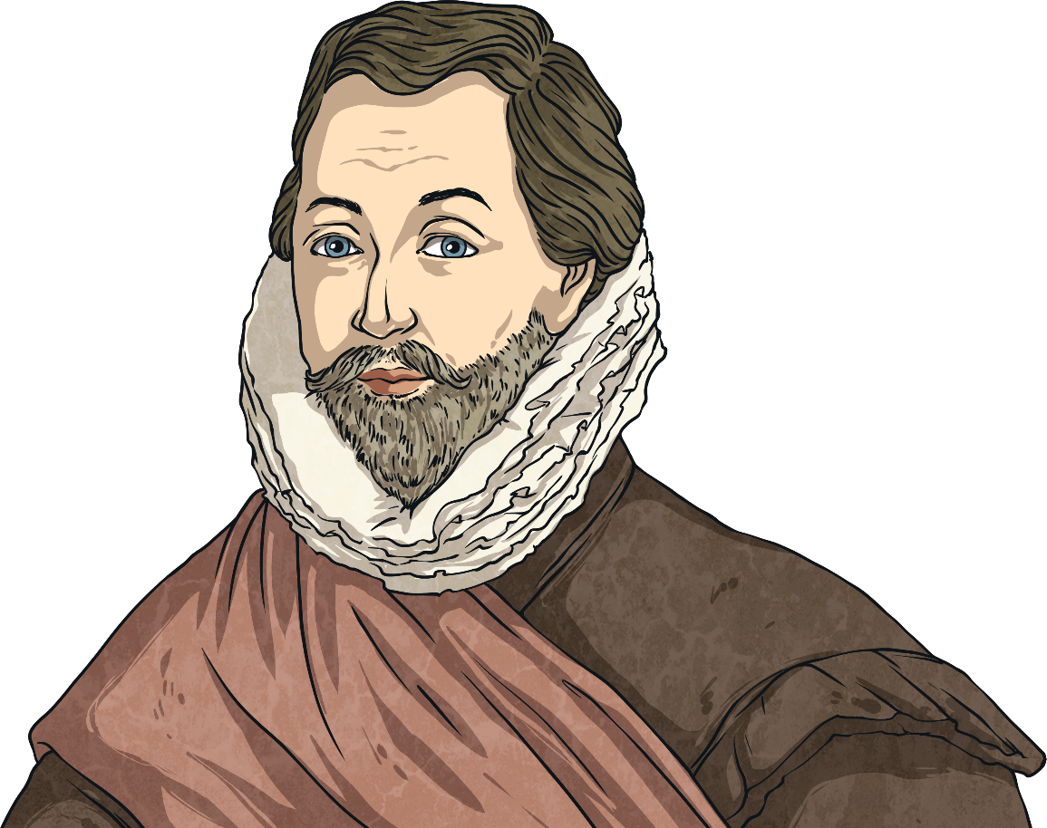
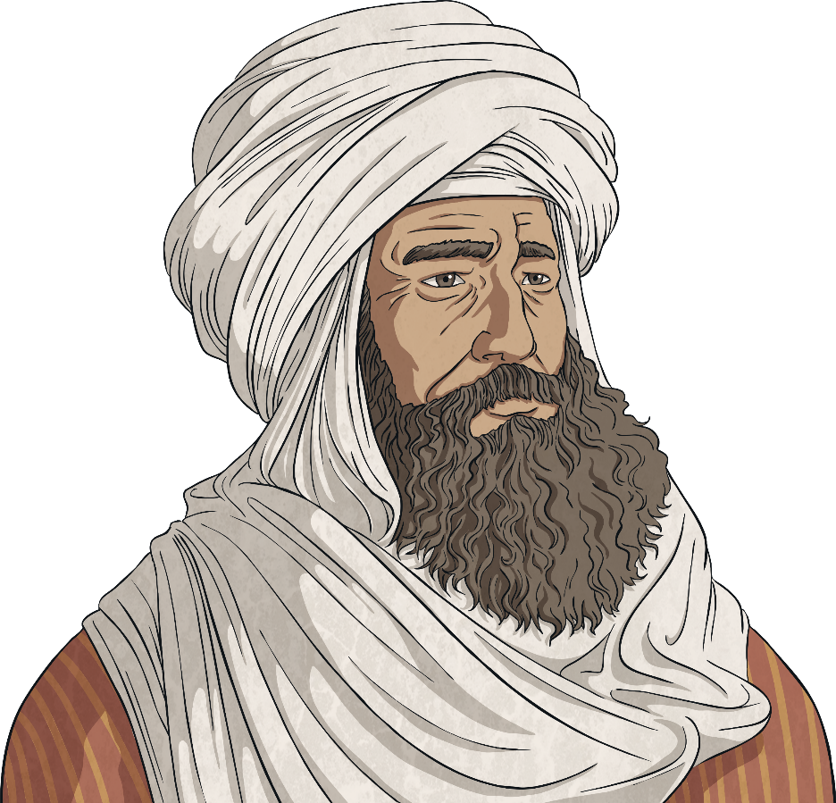
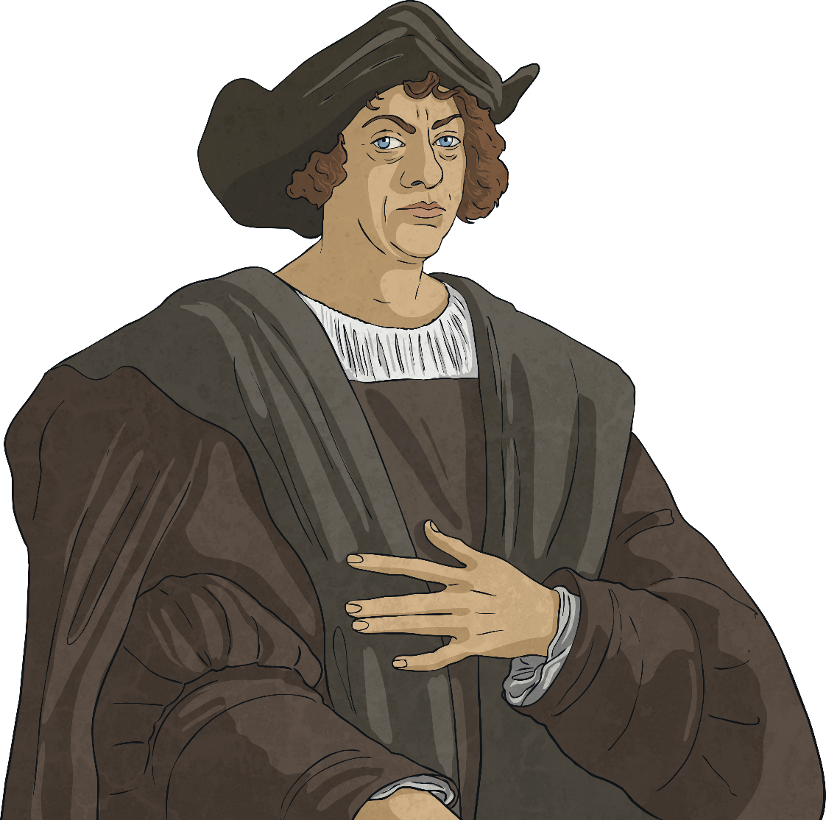
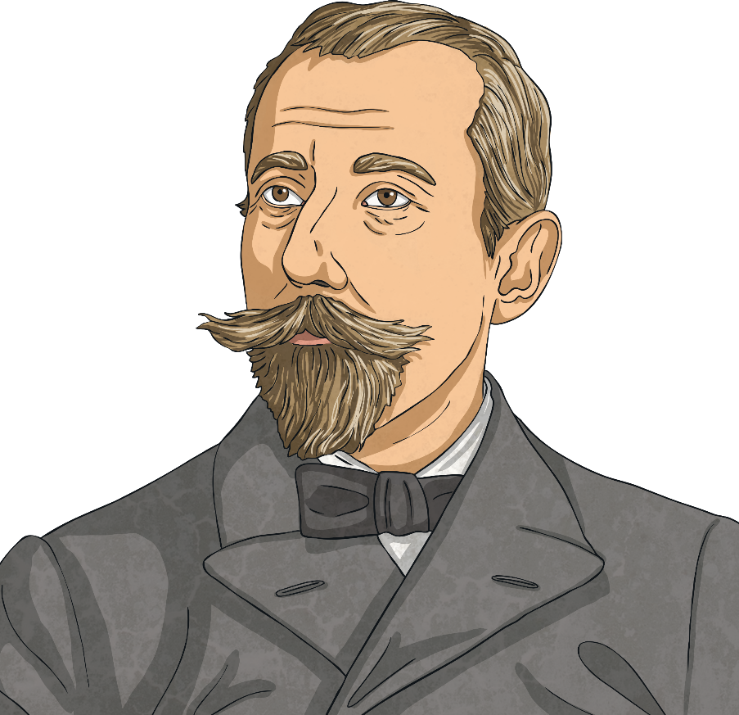
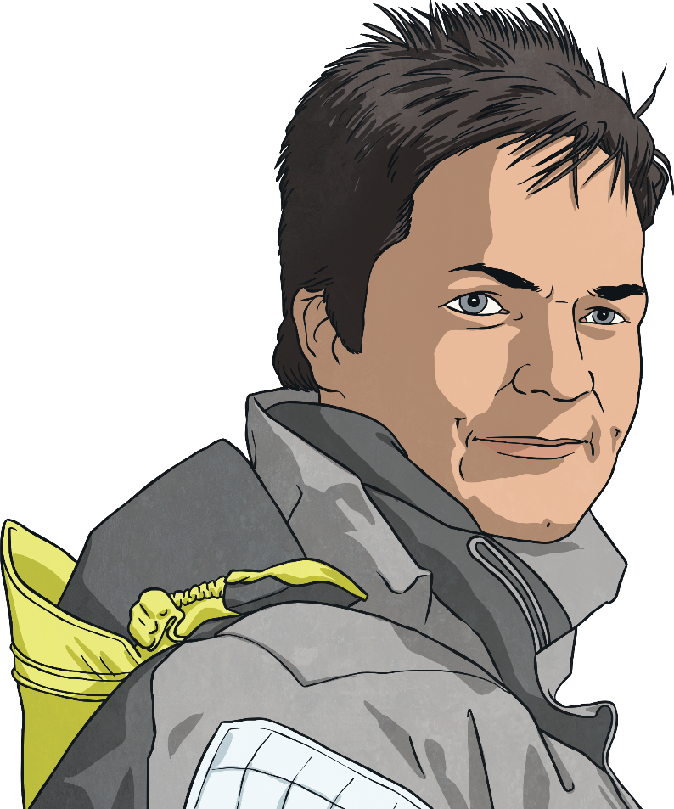
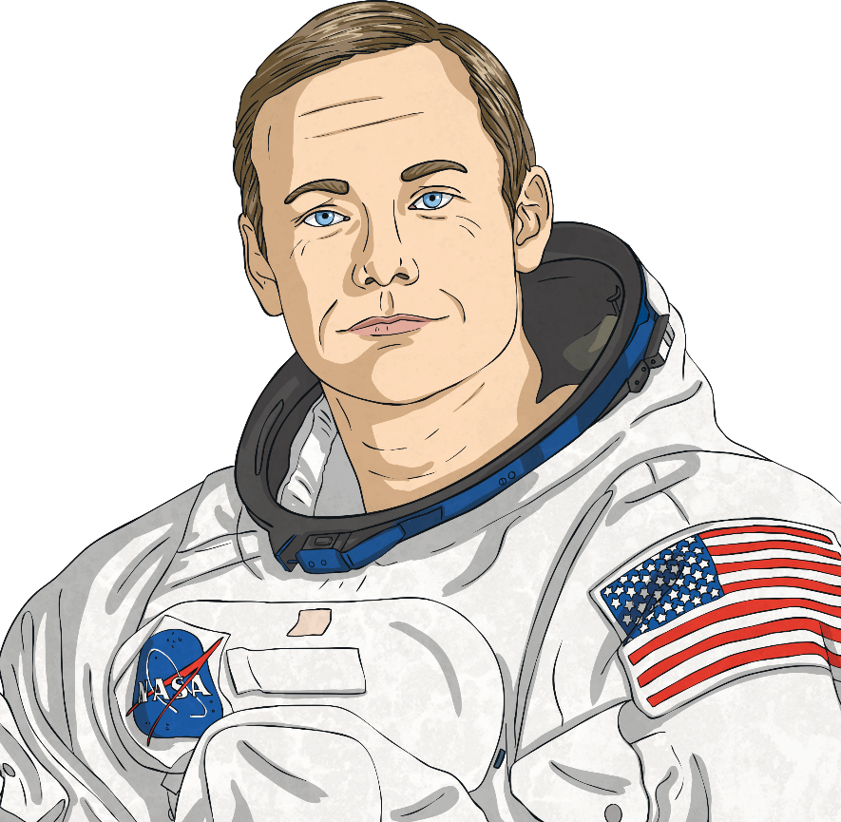
Explorers
Throughout history, humans have explored unknown places.
Ellen MacArthur was the fastest person to sail round the world singlehandedly.
In the 14th century, Ibn Battuta spent over 30 years travelling nearly 120,000km around the world.
In 1492, Christopher Columbus travelled west in the hope of reaching China. Instead, he ended up in the Caribbean.
Sir Francis Drake was one of the first people to navigate the Straights of Magellan to reach the Pacific Ocean in 1578.
Roald Amundsen led the first team to reach the South Pole.
In 1969, Neil Armstrong was the first person to walk on the Moon.

Slide 3
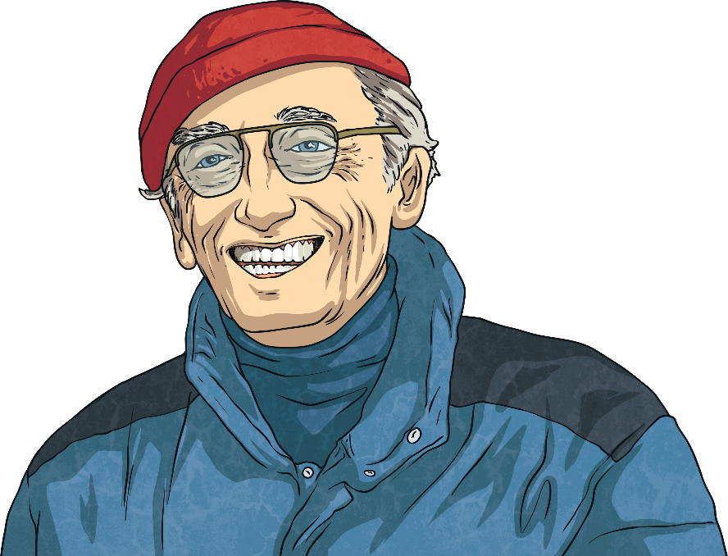
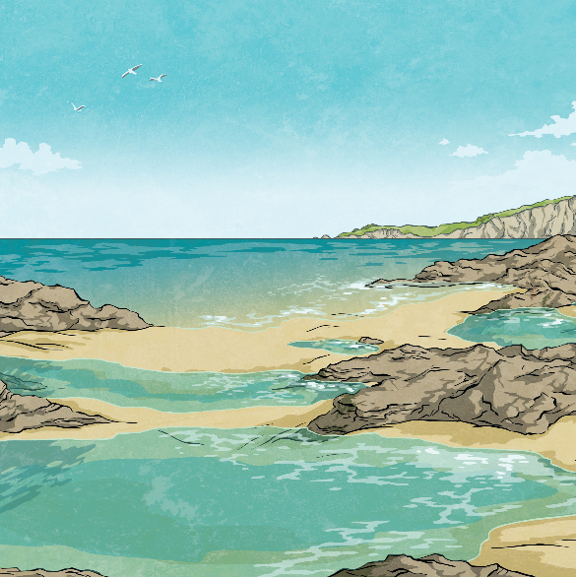
Jacques Cousteau
Jacques Cousteau (pronounced Jack – with a soft ‘j’ – Coos-toh) was a famous explorer of the seas.
He was born on 11th June 1910 in France. Jacques learnt to swim when he was aged four and loved the water. In 1930, Jacques joined the French Navy. While training to be a pilot, Jacques was in a serious car crash. He suffered broken bones all over his body. His injuries meant he was no longer able to become a pilot.
Talk About It
Have you ever faced disappointment? What happened? How did you deal with it?
Jacques continued to serve in the navy. One day in 1936, he was swimming in the sea while wearing goggles. This moment sparked a life-long love of diving and ocean exploration.

Slide 4
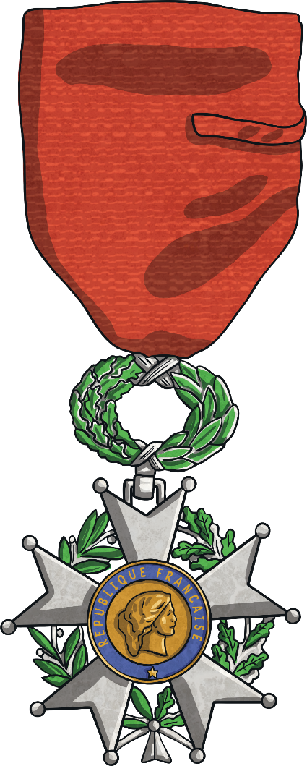
Second World War
During the Second World War, France was invaded by Germany. France was split into two areas, the Occupied Zone, ruled directly by Germany and the Free Zone, ruled by French people who supported Nazi ideals. The Free Zone was also known as Vichy France.
Jacques continued to serve in the French Navy during the war.
He also joined the French Resistance. This was a group of people
who fought against the Nazis and the leaders of Vichy France.
Jacques spied on troop movements which helped the Allies fight
the war. For his work, Jacques was awarded the Legion d’Honneur,
France’s highest military award.
After the war, Jacques helped clear seas of underwater mines left from the war.

Slide 5
Underwater Films
As Jacques continued to develop his love of underwater exploration, he liked the thought of being able to share his discoveries with other people. In 1943, he made the first French underwater film called ‘18 Metres Deep’. It was filmed by putting a camera in a special case that was deep water pressure-proof. Jacques made the film without using breathing equipment.
Jacques knew that to explore further and create more films, he would need to find a way to dive deeper and stay underwater for longer.

Slide 6
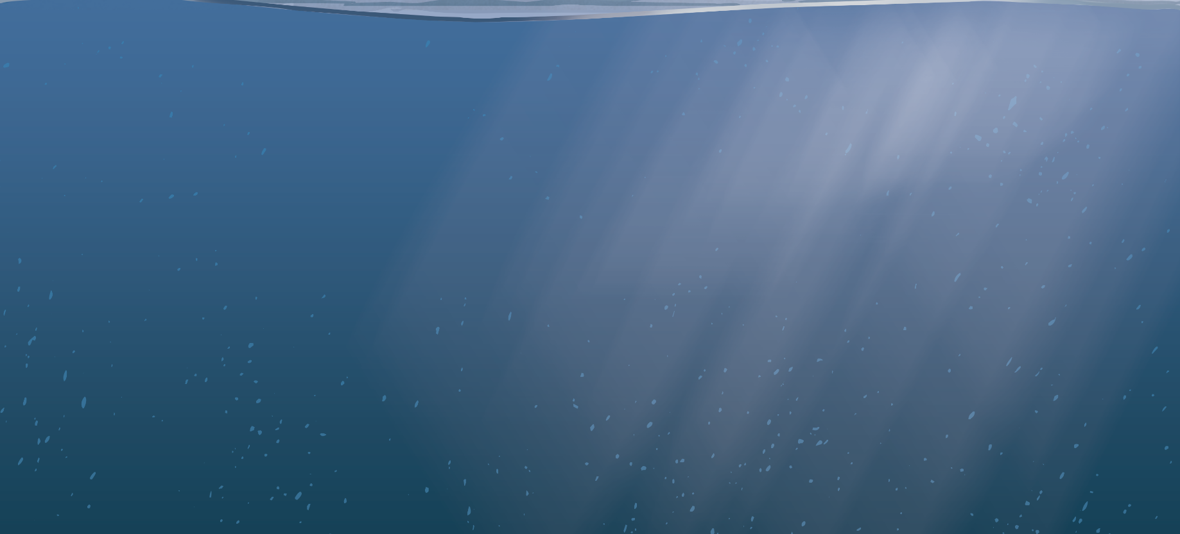
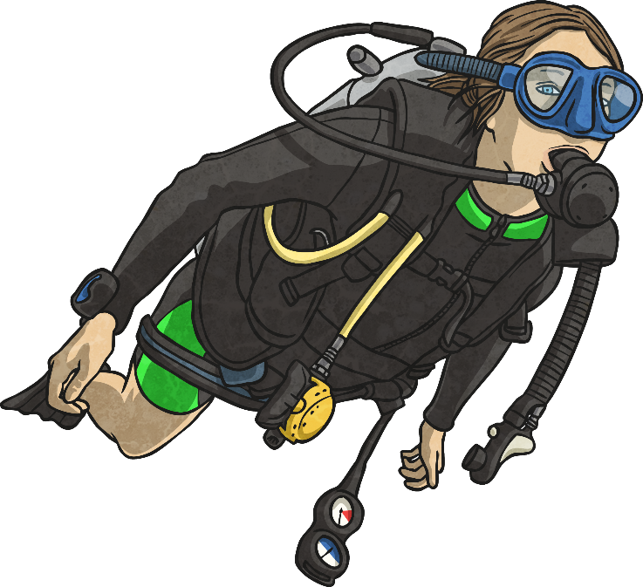
SCUBA
Working with an engineer called Emile Gagnan, Jacques invented the Self-Contained Underwater Breathing Apparatus or scuba. It was also known as an aqua-lung.
It worked by using a regulator. Divers could breathe in and out of the same mouth piece, which was attached to the regulator. The regulator was connected to an air tank which the diver wore on their back.
Before this invention, if people wanted to go deep sea diving, they had to wear a diving suit that was connected by a hose to a tank either on land or on a boat. The aqua-lung enabled divers to explore waters deeper than ever before.

Slide 7
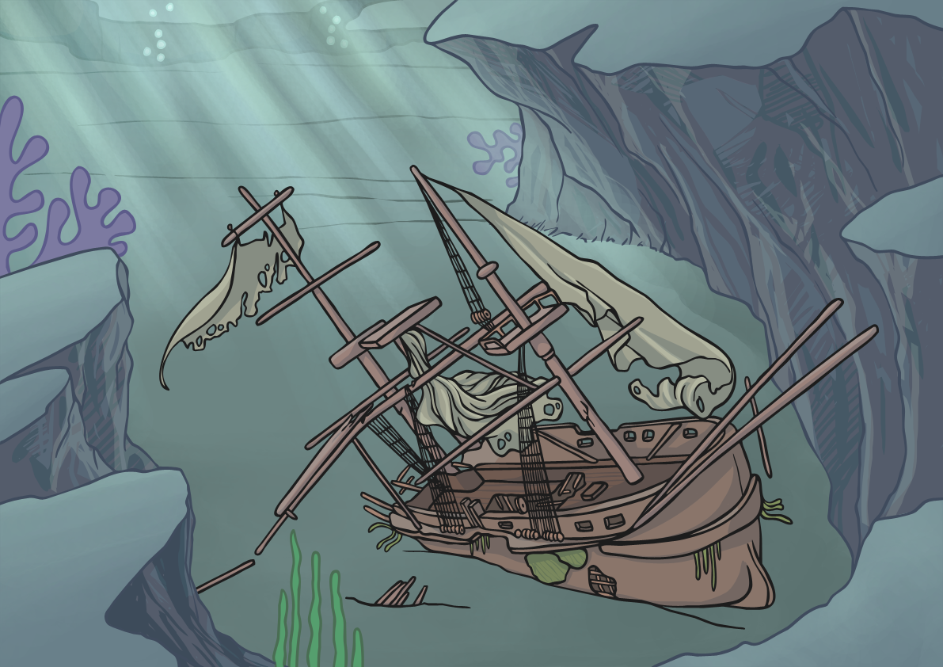
Mousquemers
Jacques worked with his friends Philippe Tailliez and Frédéric Dumas, carrying out underwater experiments. They became known as Mousquemers (French for ‘the musketeers of the sea’).
Talk About It
Do you or anyone you know have a nickname? Why was the nickname chosen? Who invented it?
In 1947, Jacques set a world record when he dived 300 feet below sea level.
Jacques filmed his underwater exploration of the Mahdia shipwreck off the coast of Tunisia. The vessel was wrecked in around the year 80 BC. In 1953, Jacques wrote a book called ‘The Silent World’ about his adventures. Underwater archaeology became more popular thanks to Jacques’ work.

Slide 8
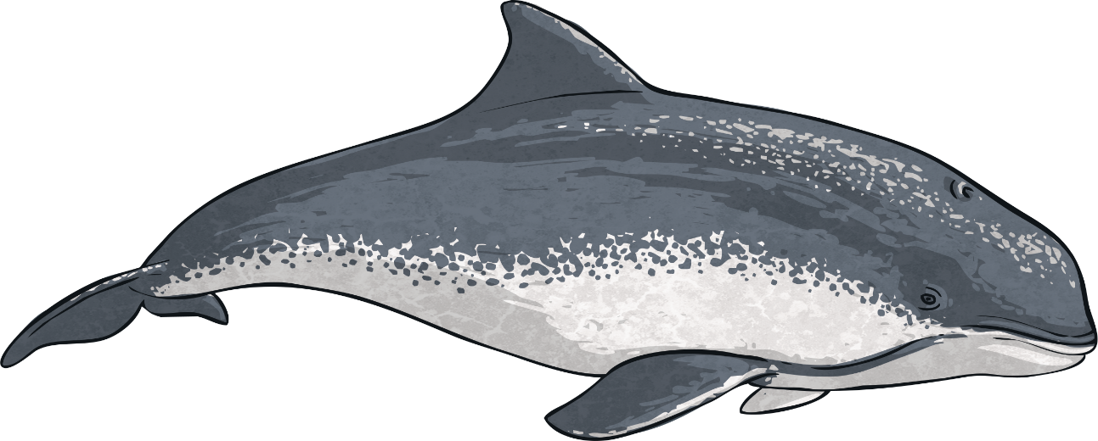
The Calypso
In 1950, Jacques started sailing a ship called the Calypso. The Calypso had special scientific and diving equipment.
In 1956, Jacques turned his book ‘The Silent World’ into an award-winning film. The money from the film enabled Jacques to explore the Red Sea and the Indian Ocean.
Jacques observed porpoises swimming near his boat and saw that they changed direction when the boat did. He predicted that the porpoises must use something like sonar to detect when objects move. We now know this feature as echolocation.

Slide 9
The Undersea World of Jacques Cousteau
In 1968, Jacques started his own television show called ‘The Undersea World of Jacques Cousteau’.
The show was incredibly popular, with millions of people watching Jacques and his crew exploring the world’s oceans and learning more about underwater living things.
As Jacques explored more, he began to realise how human activity was destroying oceans. In 1973, Jacques and two of his sons started The Cousteau Foundation which aimed to raise awareness of the importance of looking after our oceans. Jacques continued to write books and make films about marine life.
Jacques died on 25th June 1997. He was 87 years old.

Slide 10
Under the Sea
Jacques predicted that humans would one day be able to live underwater. He said “Everything that has been done on the surface will sooner or later be done underwater. It will be the conquest of a whole new world.”
Talk About It
Do you think Jacques’ prediction is right? Why or why not? Would you like to live under the sea?
Why or why not?

