Slide 1
Challenger deep
Mariana Trench

Slide 2
The Challenger Deep is the deepest place in the world's oceans. It is a slot at the southern end of the Marianas Trench. The ocean floor is about seven miles beneath the surface of the Pacific Ocean in the slot. Geologists list the official depth at this time as 39,994 feet.
HMS Challenger The slot was discovered during an expedition of the British Navy aboard the HMS Challenger. They were surveying areas in the Pacific Ocean from 1872 to 1876 when they found the slot.
How it was named The name Challenger was in honor of the boat they were on. The term deep was used to describe places that were deep in the ocean. The Marianas Trench is located near the Mariana Islands and is 190 miles from Guam.

Slide 3
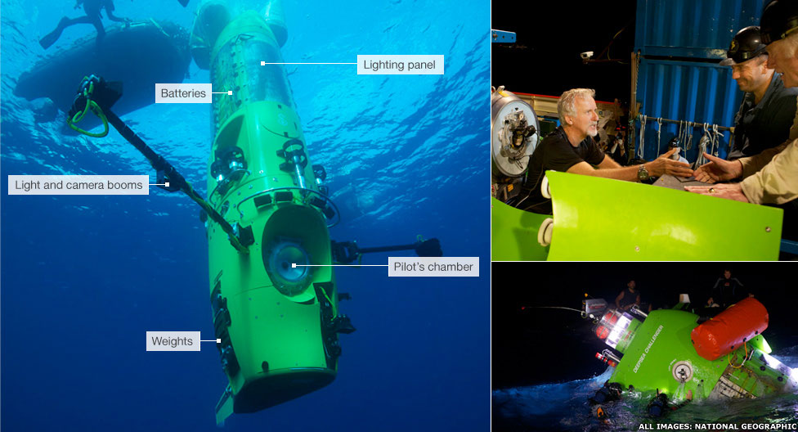
The first descent The first manned descent to the oceans deepest point occurred in 1960. On January 23, 1960 a US Navy submersible Trieste manned by Jacques Piccard and Lieutenant Don Walsh descended to the bottom of the trench. The floor of the ocean where they descended to was 35,838 feet deep.
James Cameron’s solo dive James Cameron in a solo dive went to the floor of the Challenger Deep. He recorded his trip in 3-D. It was on March 27, 2012. It took 7 years of preparation for his dive. The National Geographic Society helped James Cameron finance his dive. Because of the murky water he was not able to take a major set of pictures while he was on the floor of the Challenger Deep. He plans to return in the future with another mini-sub.
Five Deeps Expedition Victor Vescovo, an American explorer, finished his five dives to the deepest points in all the world's oceans. His deepest dive was to the bottom of the Challenger Deep. The record-breaking dive was 10,924 meters. It broke the record of the two previous dives in 1960 and 2012. His dive was completed in May 2019 and will be a documentary series on the Discovery Channel. Three new species of marine animals were discovered on the dive.
https://www.youtube.com/watch?v=LKXvdyNz6L8&safe=active

Slide 4
