Slide 1
Slaves
By Anya

Slide 2
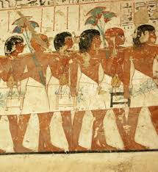
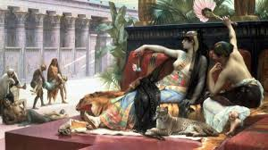
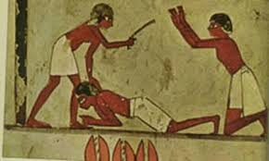
Why were slaves a thing
.Slaves were a thing so that the pharaoh could ask them to do something or build home’s and pyramids.
.Also in a pyramid the slave would be at the bottom to do all the work.
Slaves didn’t want to be a slave they were stole from their country and had to leave their friends and family.

Slide 3
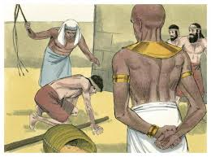
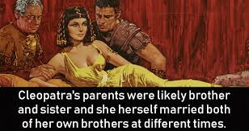
Fun facts about slaves
If Egypt did not have any slaves there would not be any pyramids.
Slaves in Egypt had an important role to build most of the great buildings there.
If a slave was to steal anything in Egypt they would get punished.
Slaves also would be punished for tomb raiding- especially if lots of things were stolen.

Slide 4
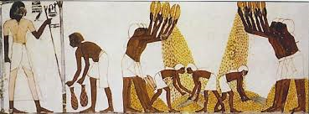
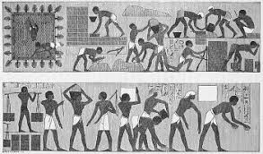
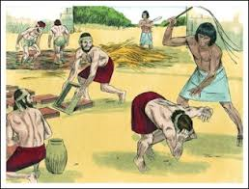
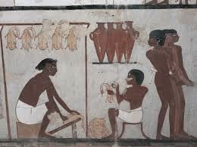
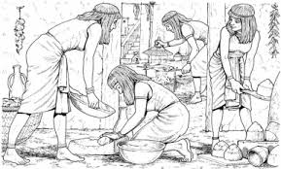
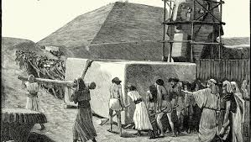
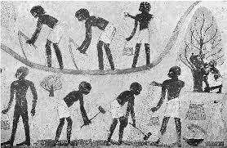
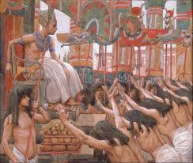
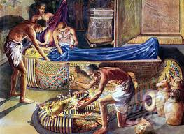
How they did it
Notes:
By Anya

